Slide 1
EBS
Easy Buy / Sell
Web/mobile programming
Team:6
Vidya Damalacheruvu
Karthik yanagandula
Gayathri Garikapati
Pujitha talluri

Slide 2
Story
Kate and Nat are close friends who are pursuing the same degree at institutions in different states.
They make a relatively small amount of money working part-time jobs.
They once intended to buy a product on sale online but were unable to do so due to a minimum purchase amount limit.

Slide 3
Story
They can use the promotion if they put all their products in one cart. However, they live in different places and were unable to discover a way to send the products to different locations.
They also wanted to split the amount and pay for the order in multiple payments because they were low on cash.
They were in desperate need of these products and couldn't find a way to purchase them for a lower price.

Slide 4
EBS - Features
Delivery of products to multiple addresses in one order.
Product donation with buyer paying the minimum charges.
Split payment (one order with payment using multiple cards)

Slide 5
Data & Details
Stripe API:
for payment options – In Progress
Need to implement functionality to capture the order details and order amount to go through payment and generate orders collection.
Algolia Search API:
for implementing search results of the product – Completed
We have created an index ‘ebs’ and add the products collection to API.

Slide 6
Database Schemas
User Schema
Product Schema
Categories Schema
Orders Schema
Reviews Schema
For this project, we are using MongoDB hosted on cloud to store data.
Stored the product images in AWS S3 bucket to reduce the database size.

Slide 7
Idea of Application
MEAN stack Web Application
Mongo DB: Database
Nodejs, Express: backend
Angular, HTML, CSS & bootstrap : frontend
Typescript

Slide 8
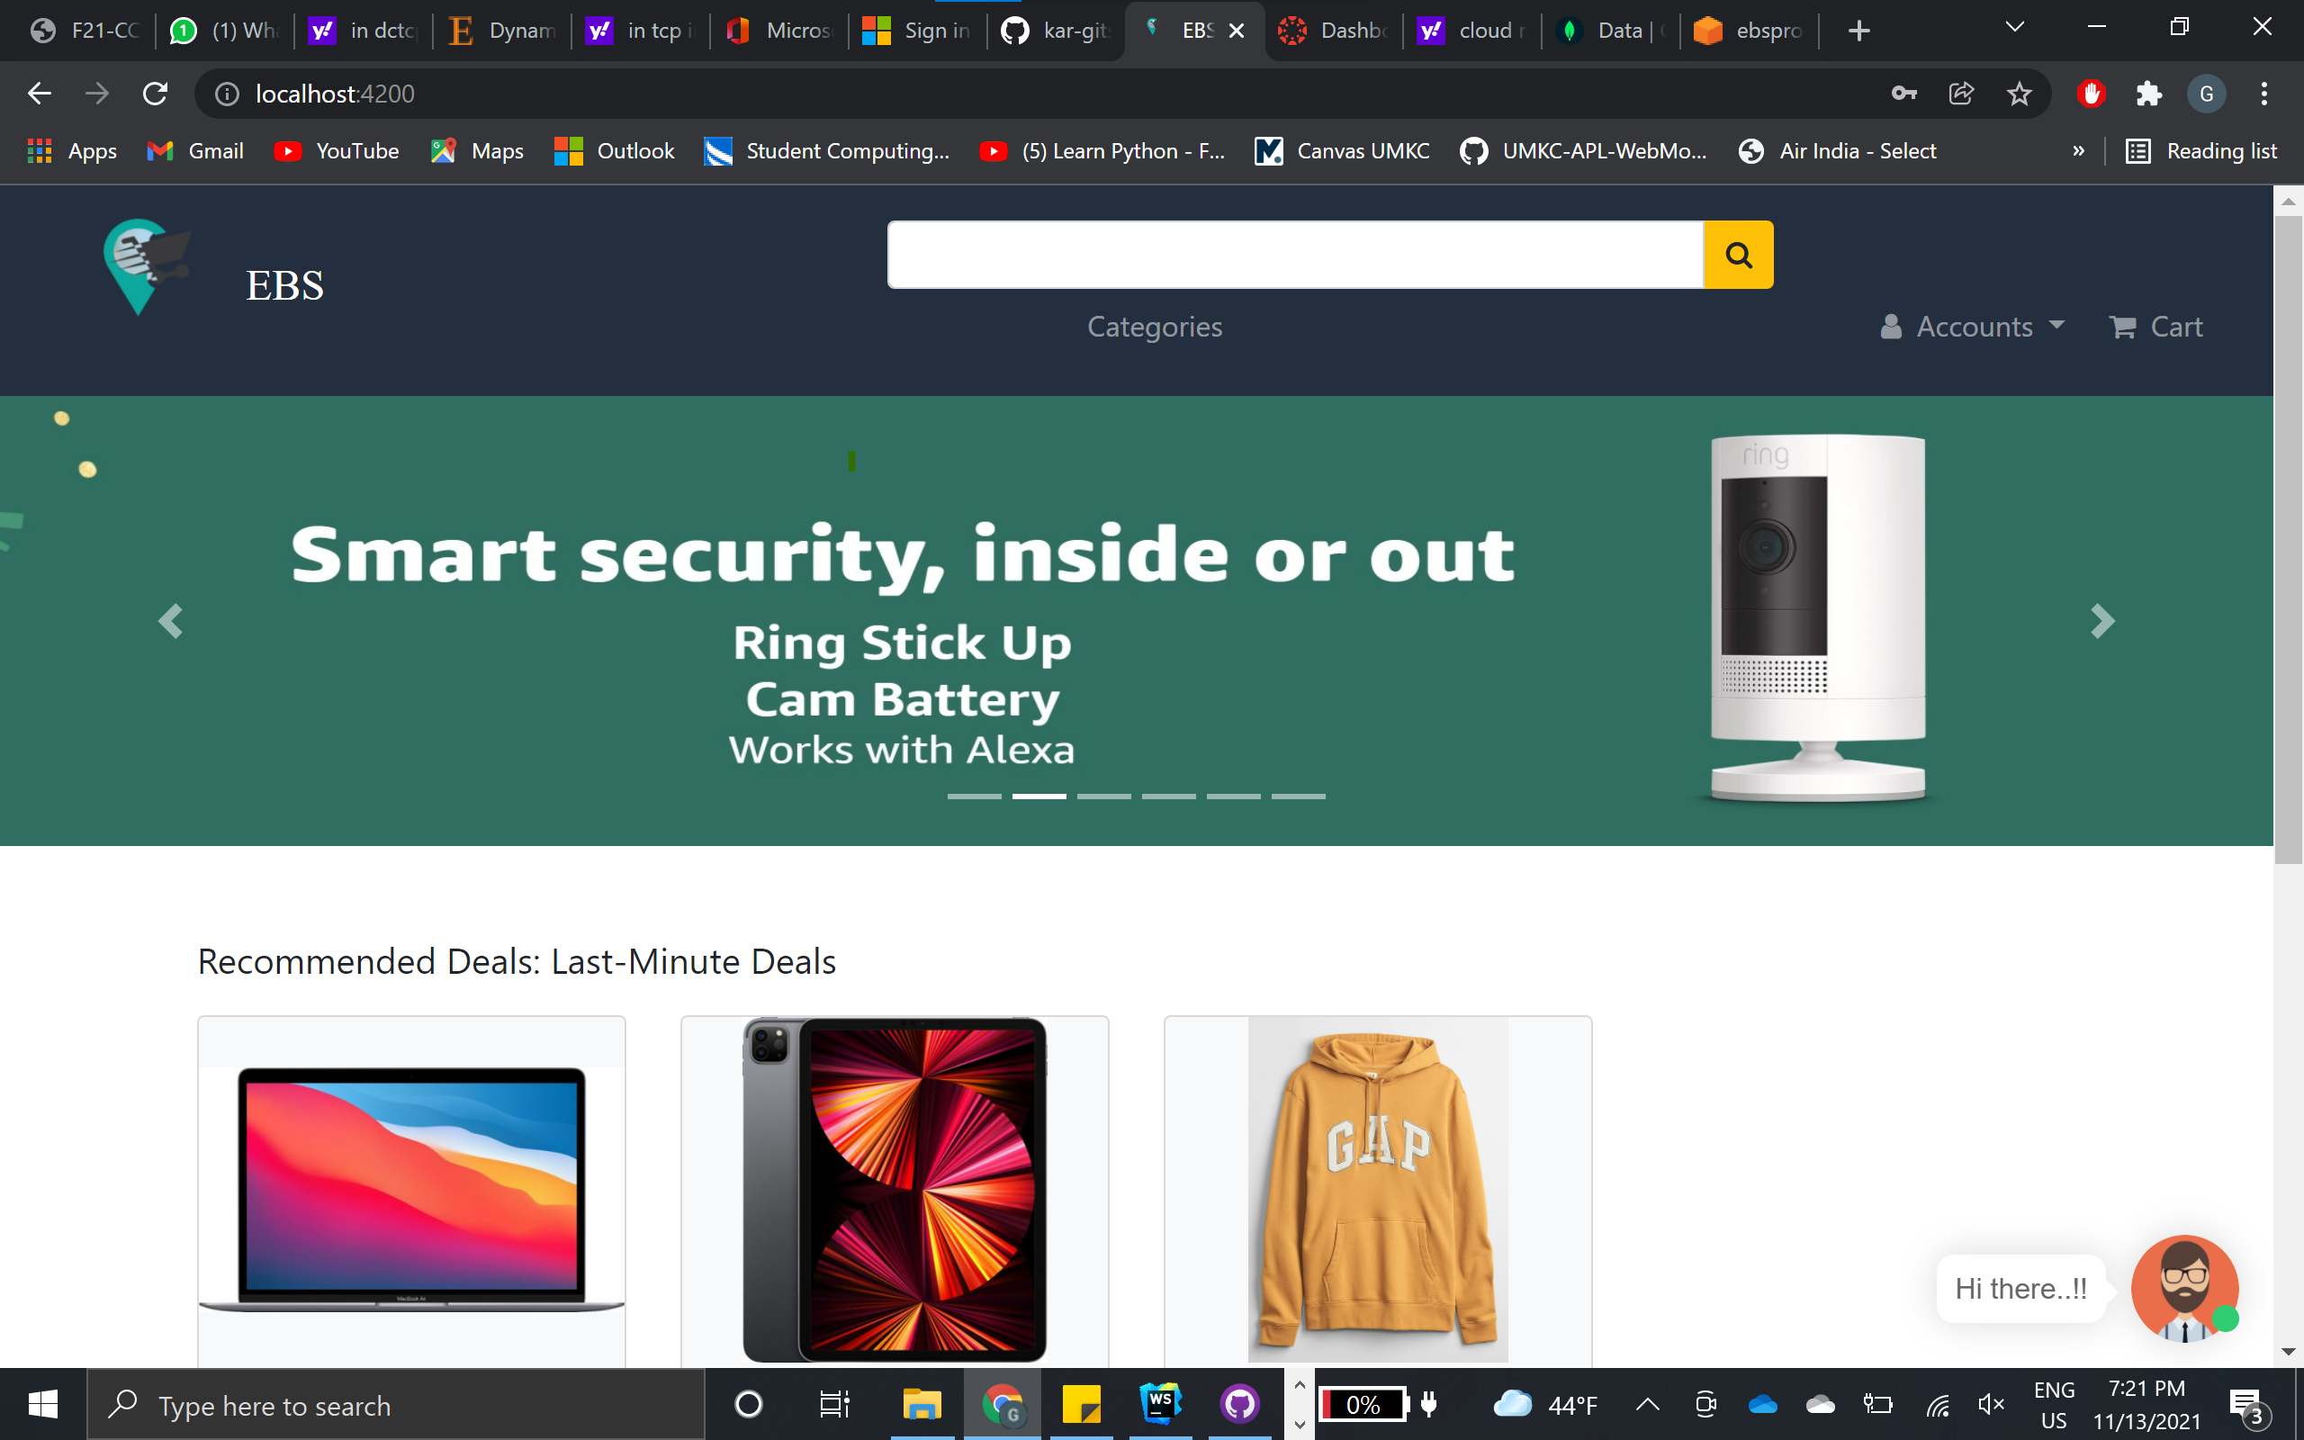
Home screen

Slide 9
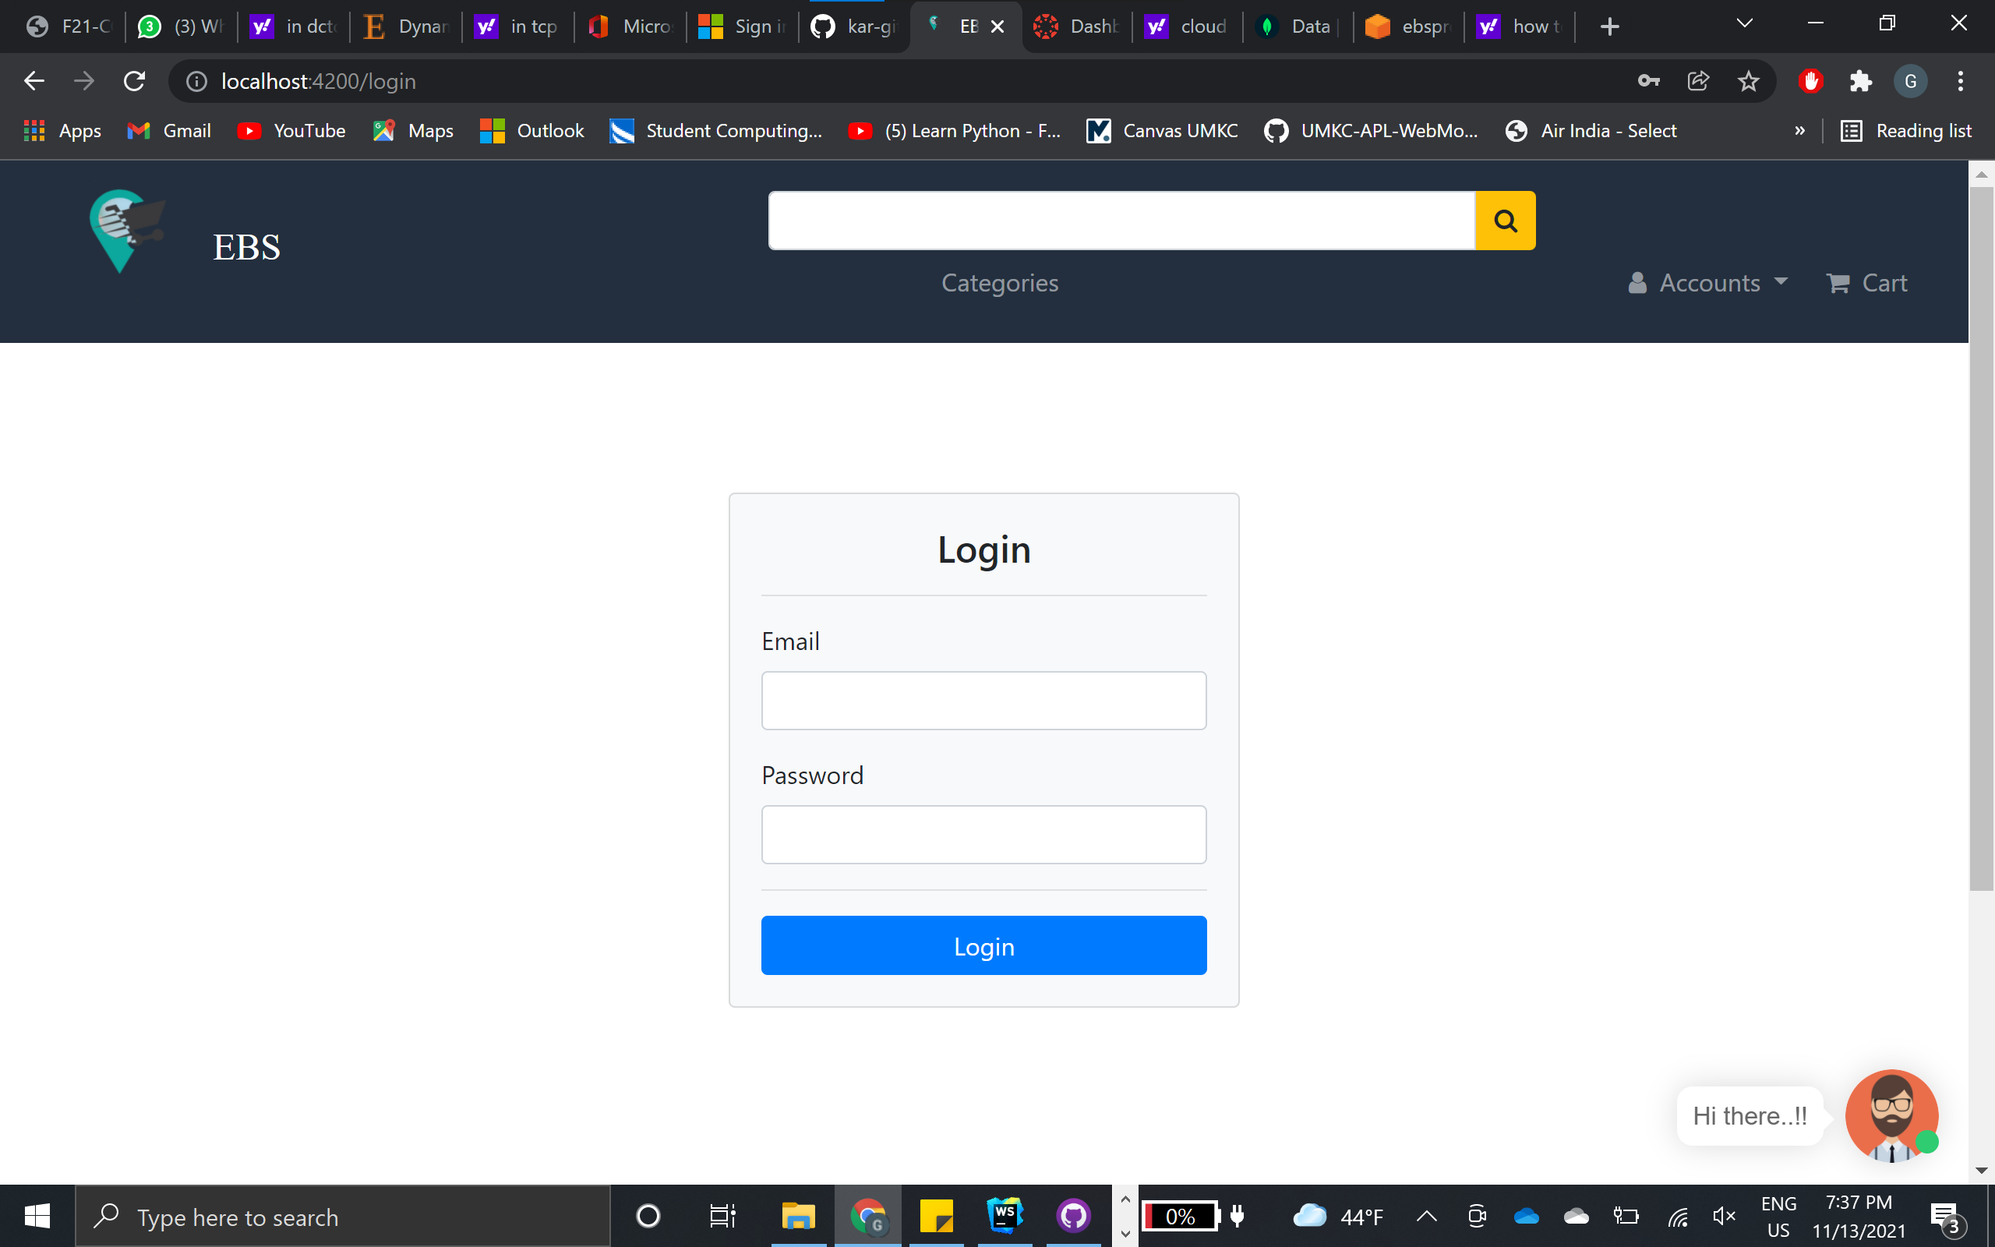
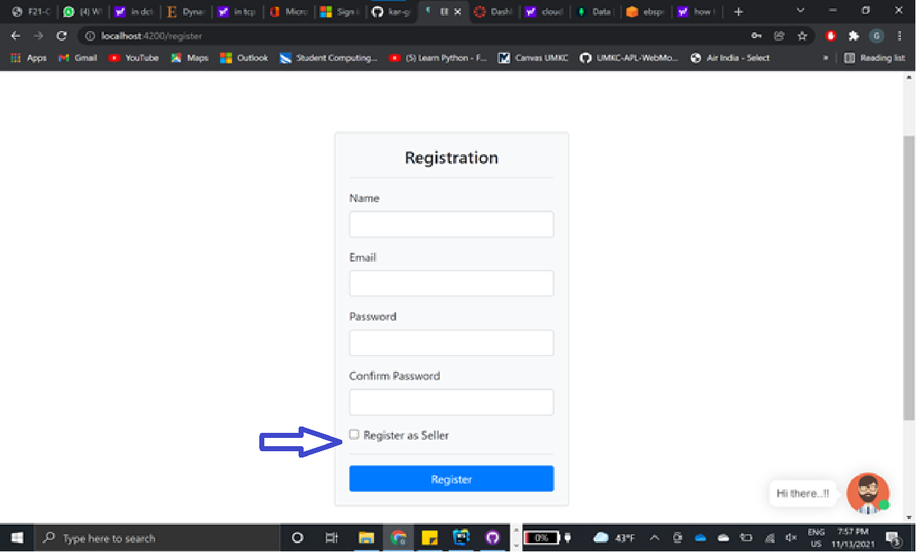
Authentication
Login
Registration

Slide 10
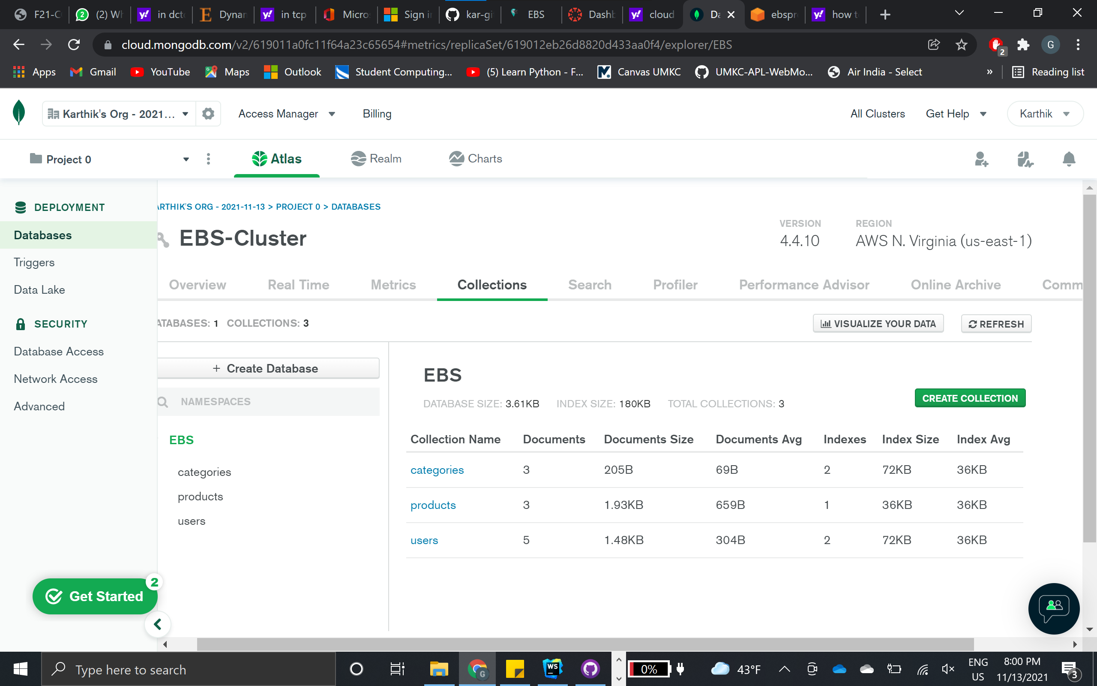
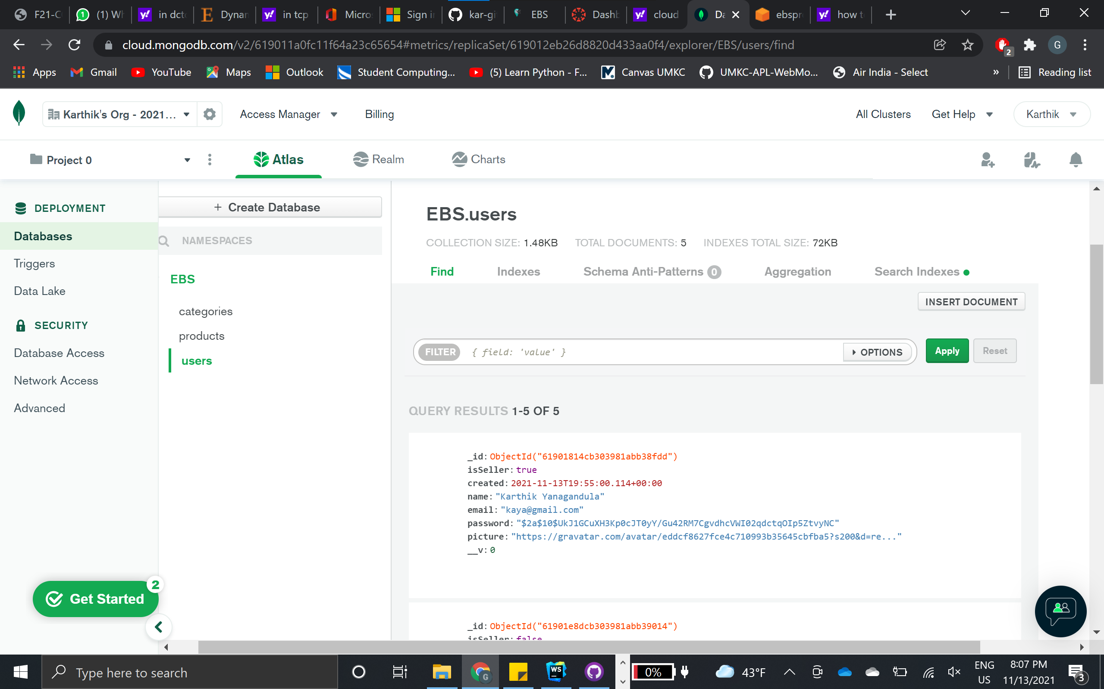
MongoDB
EBS Cluster
User schema

Slide 11
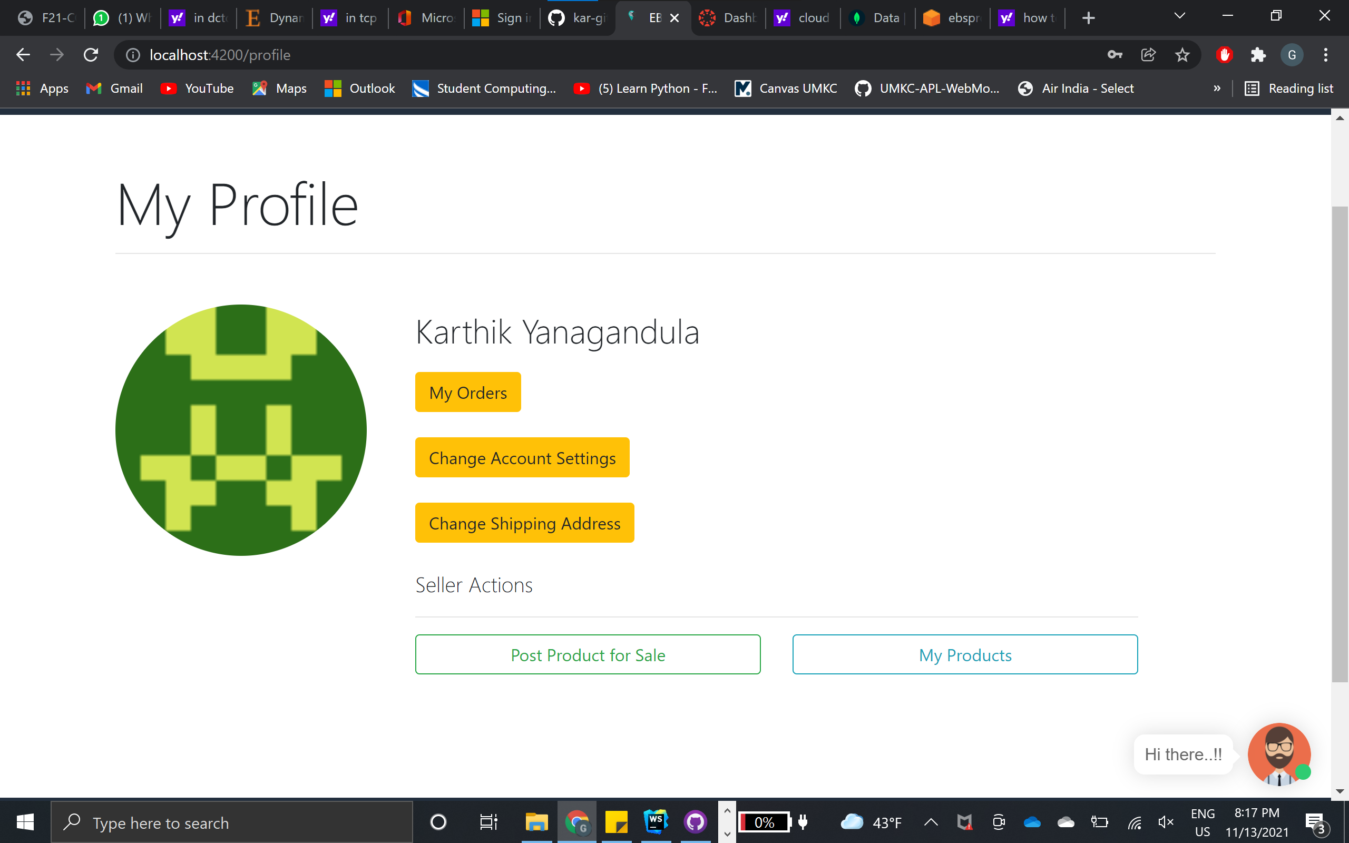
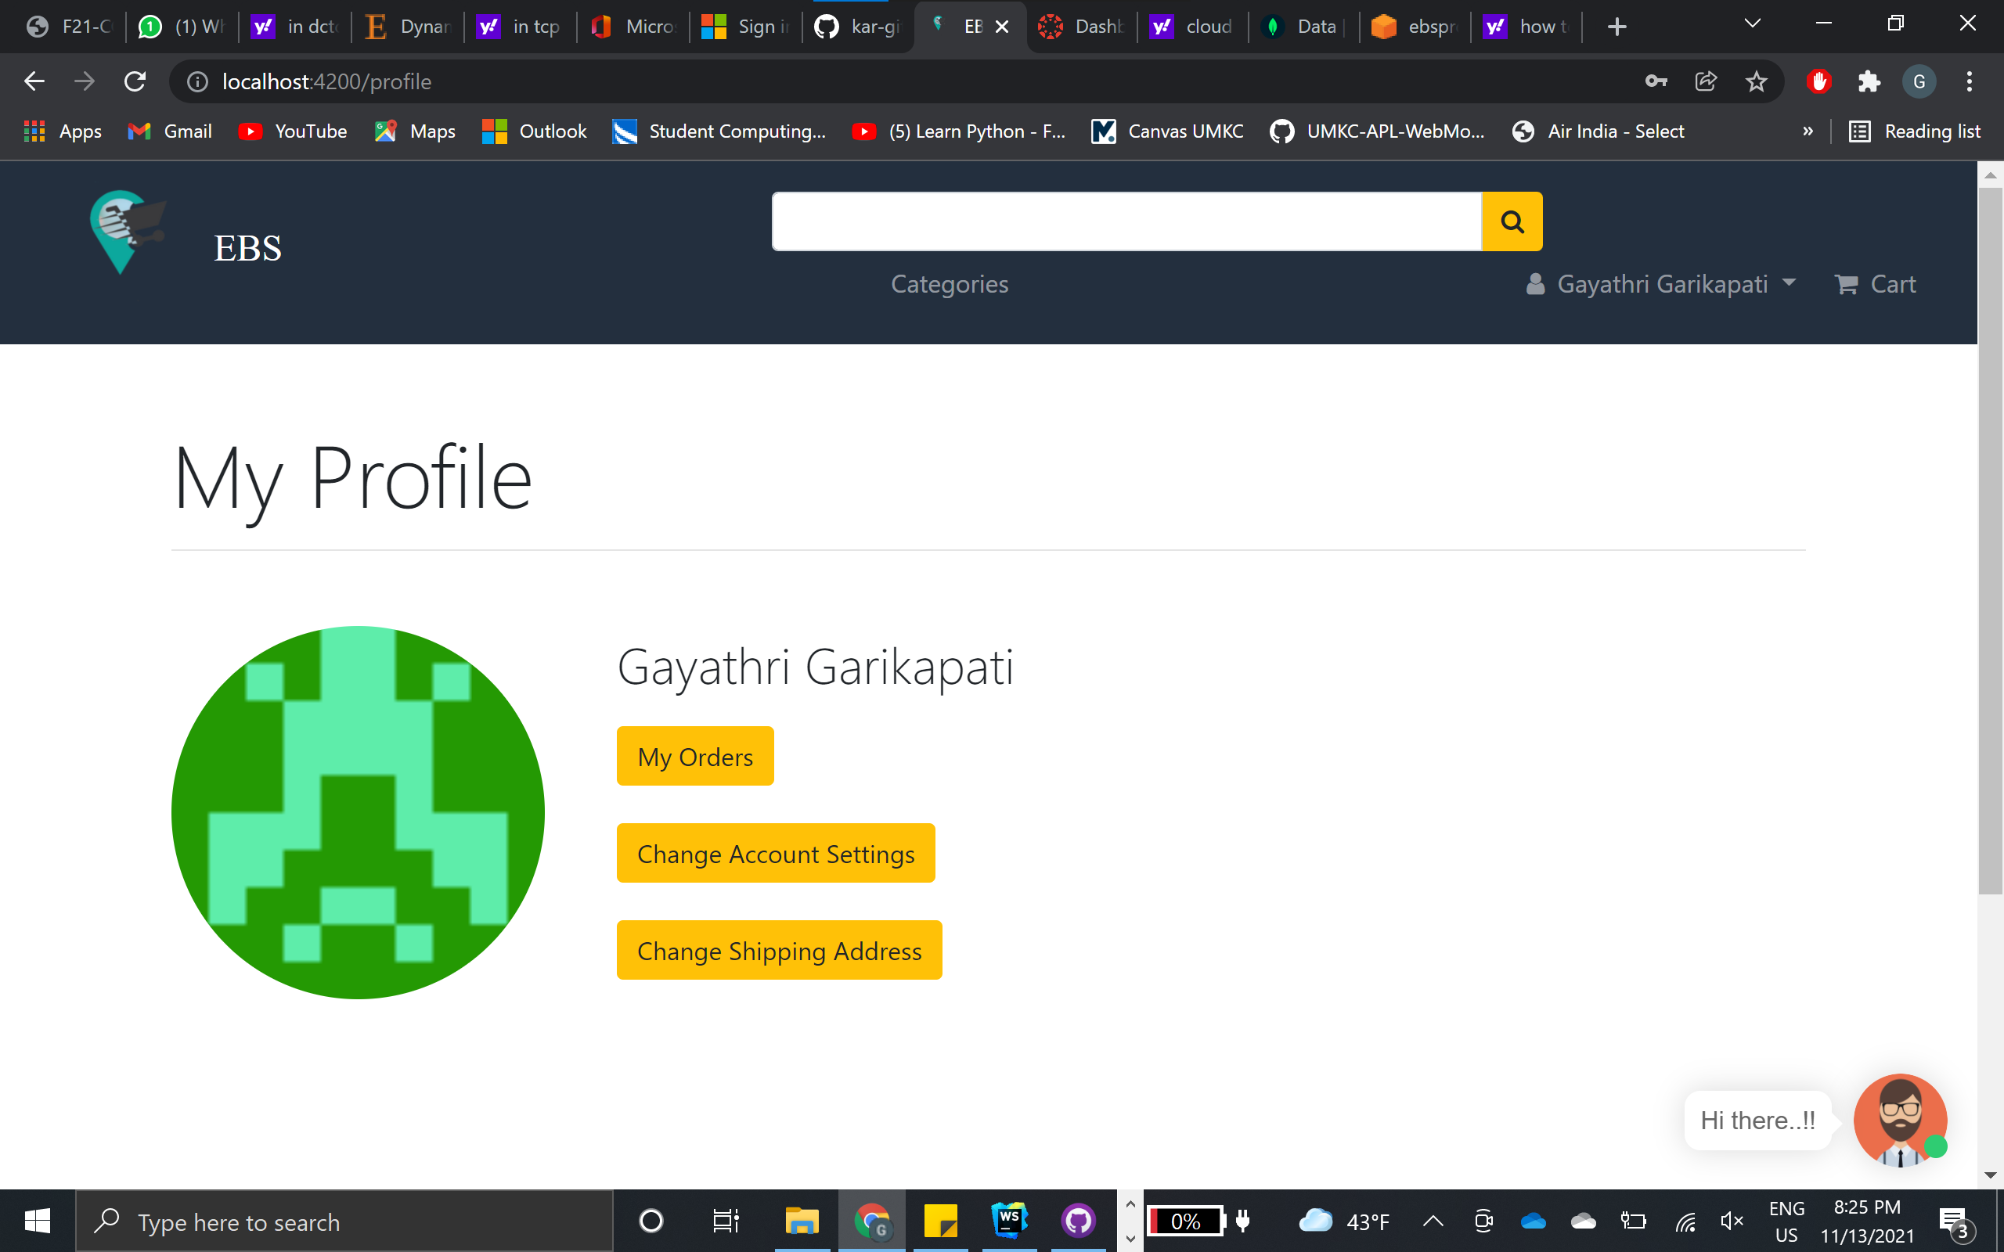
My Profile
Seller
Buyer

Slide 12
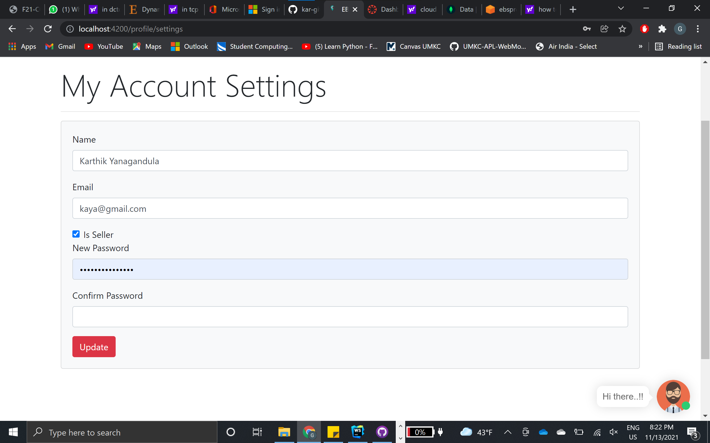
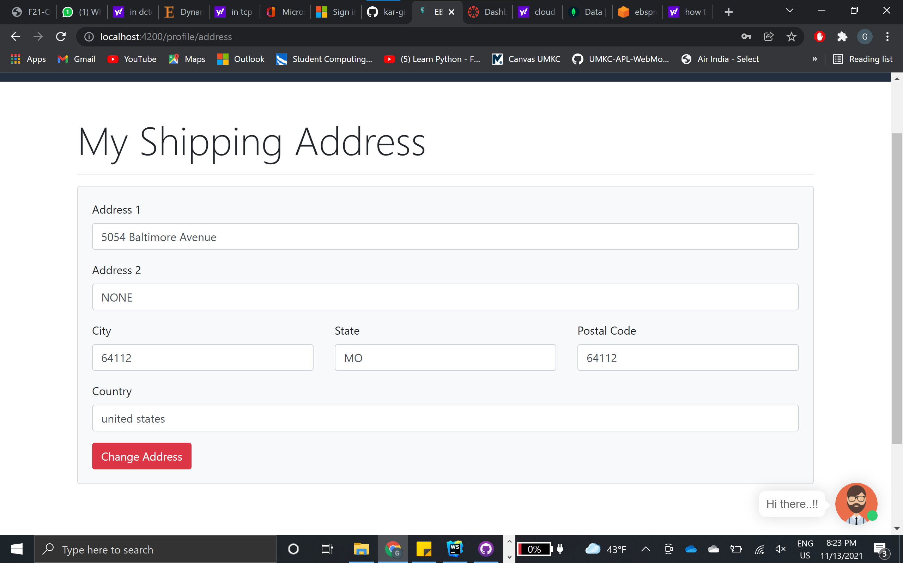
Settings

Slide 13
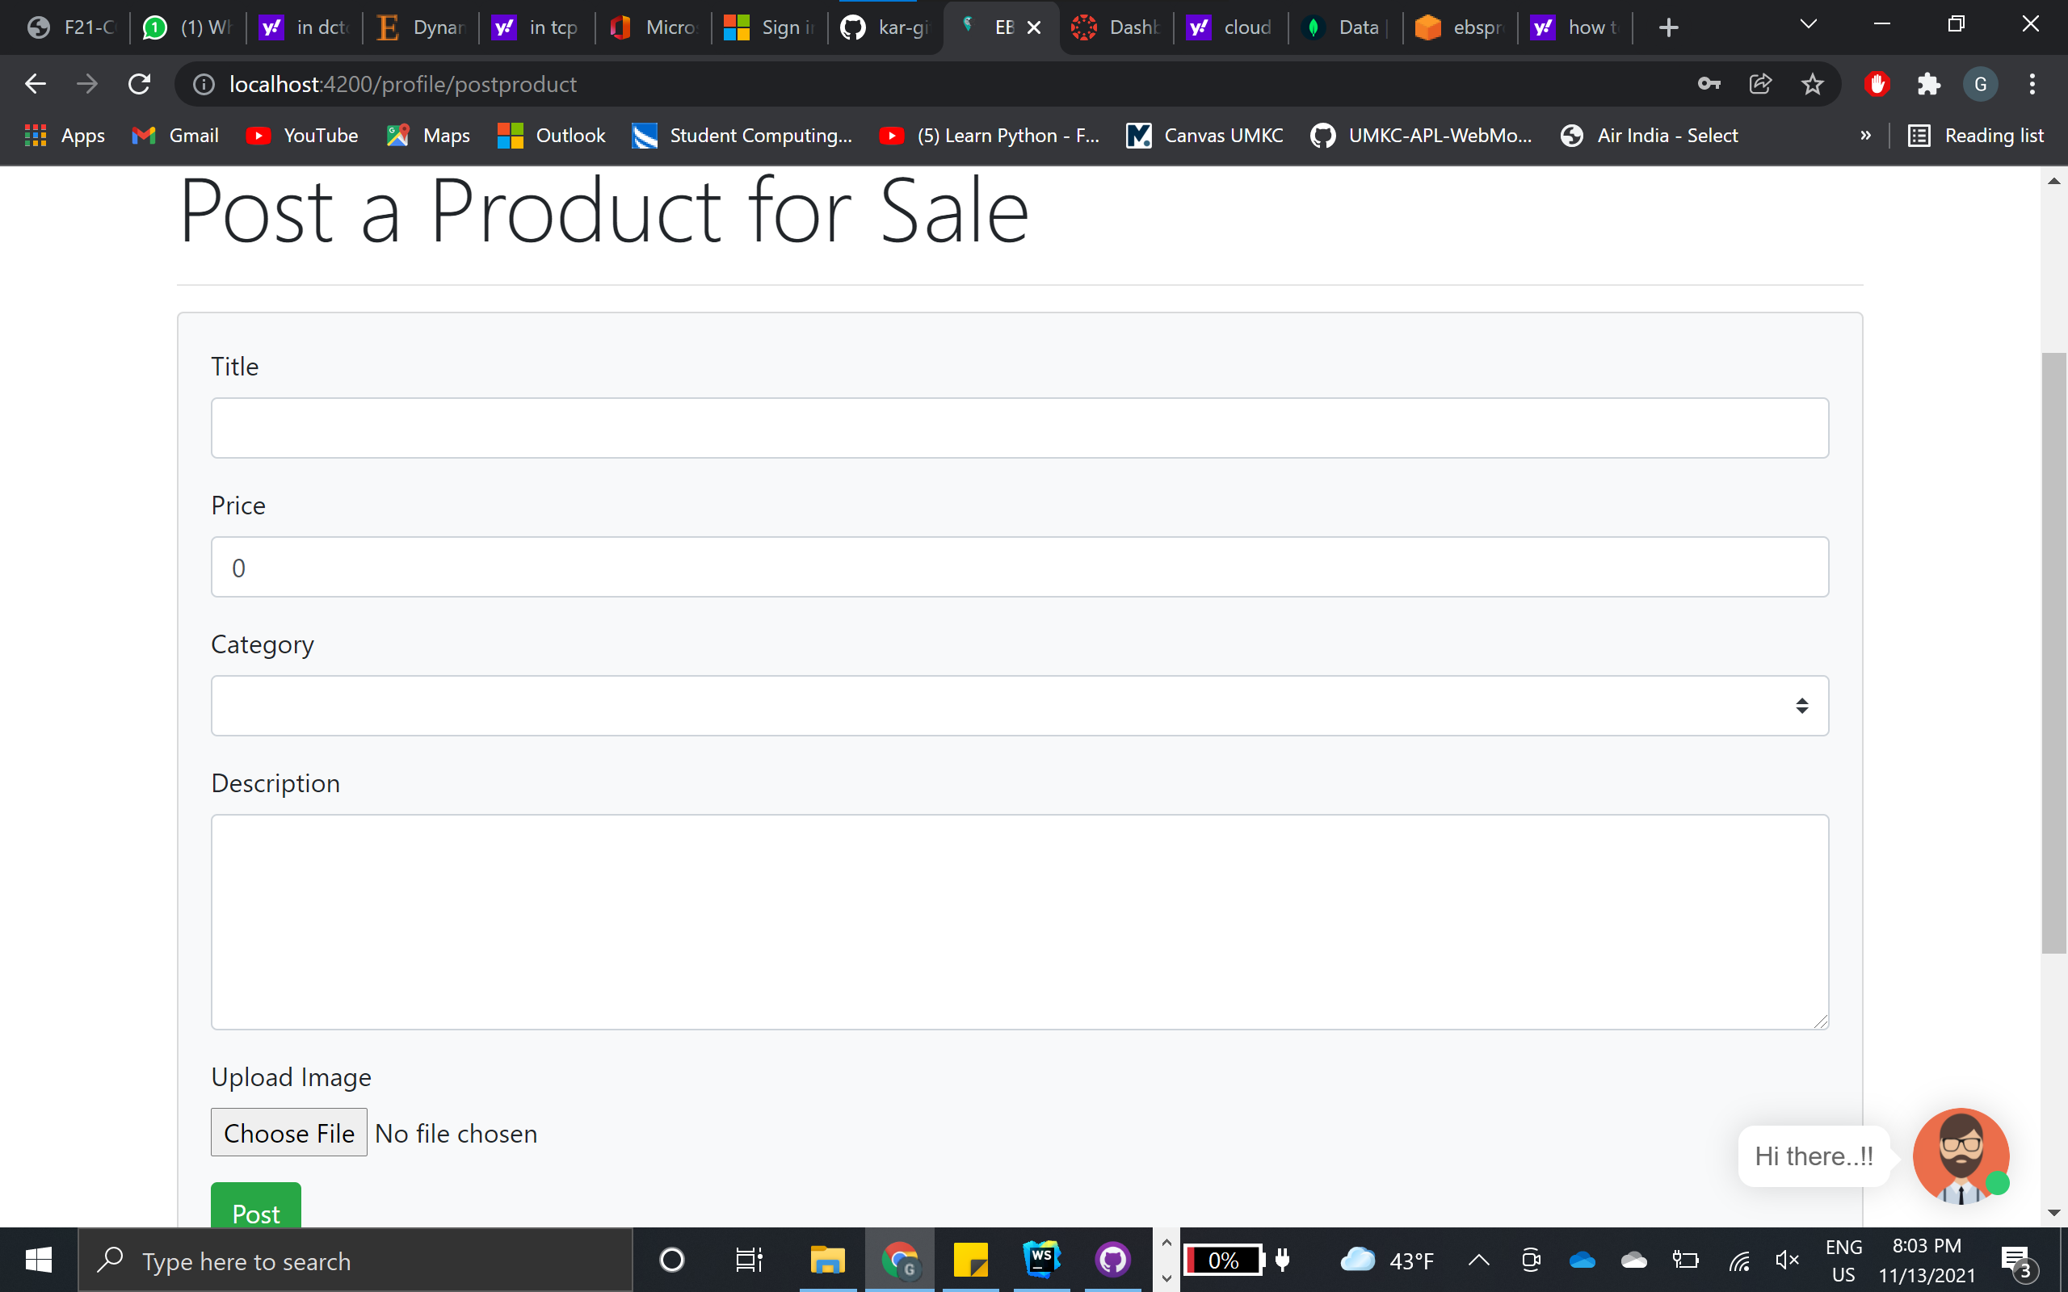
Product for sale
Title of the product
Price
Category
Description
Upload the product image

Slide 14
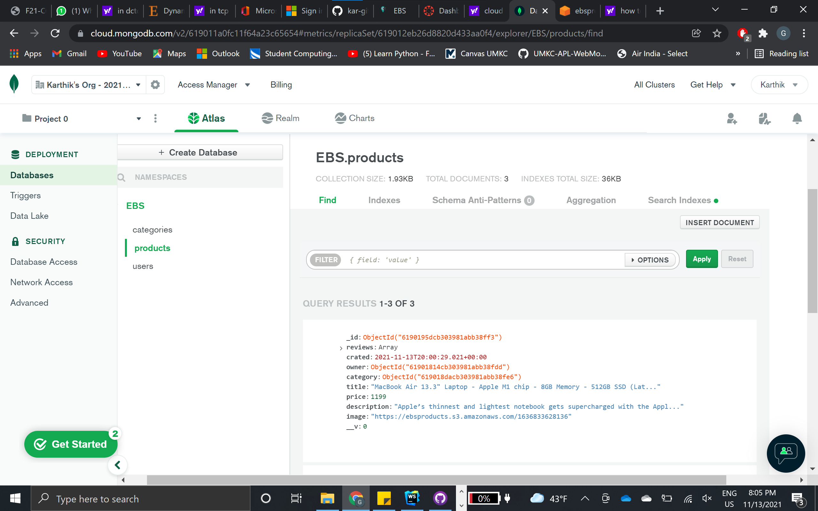
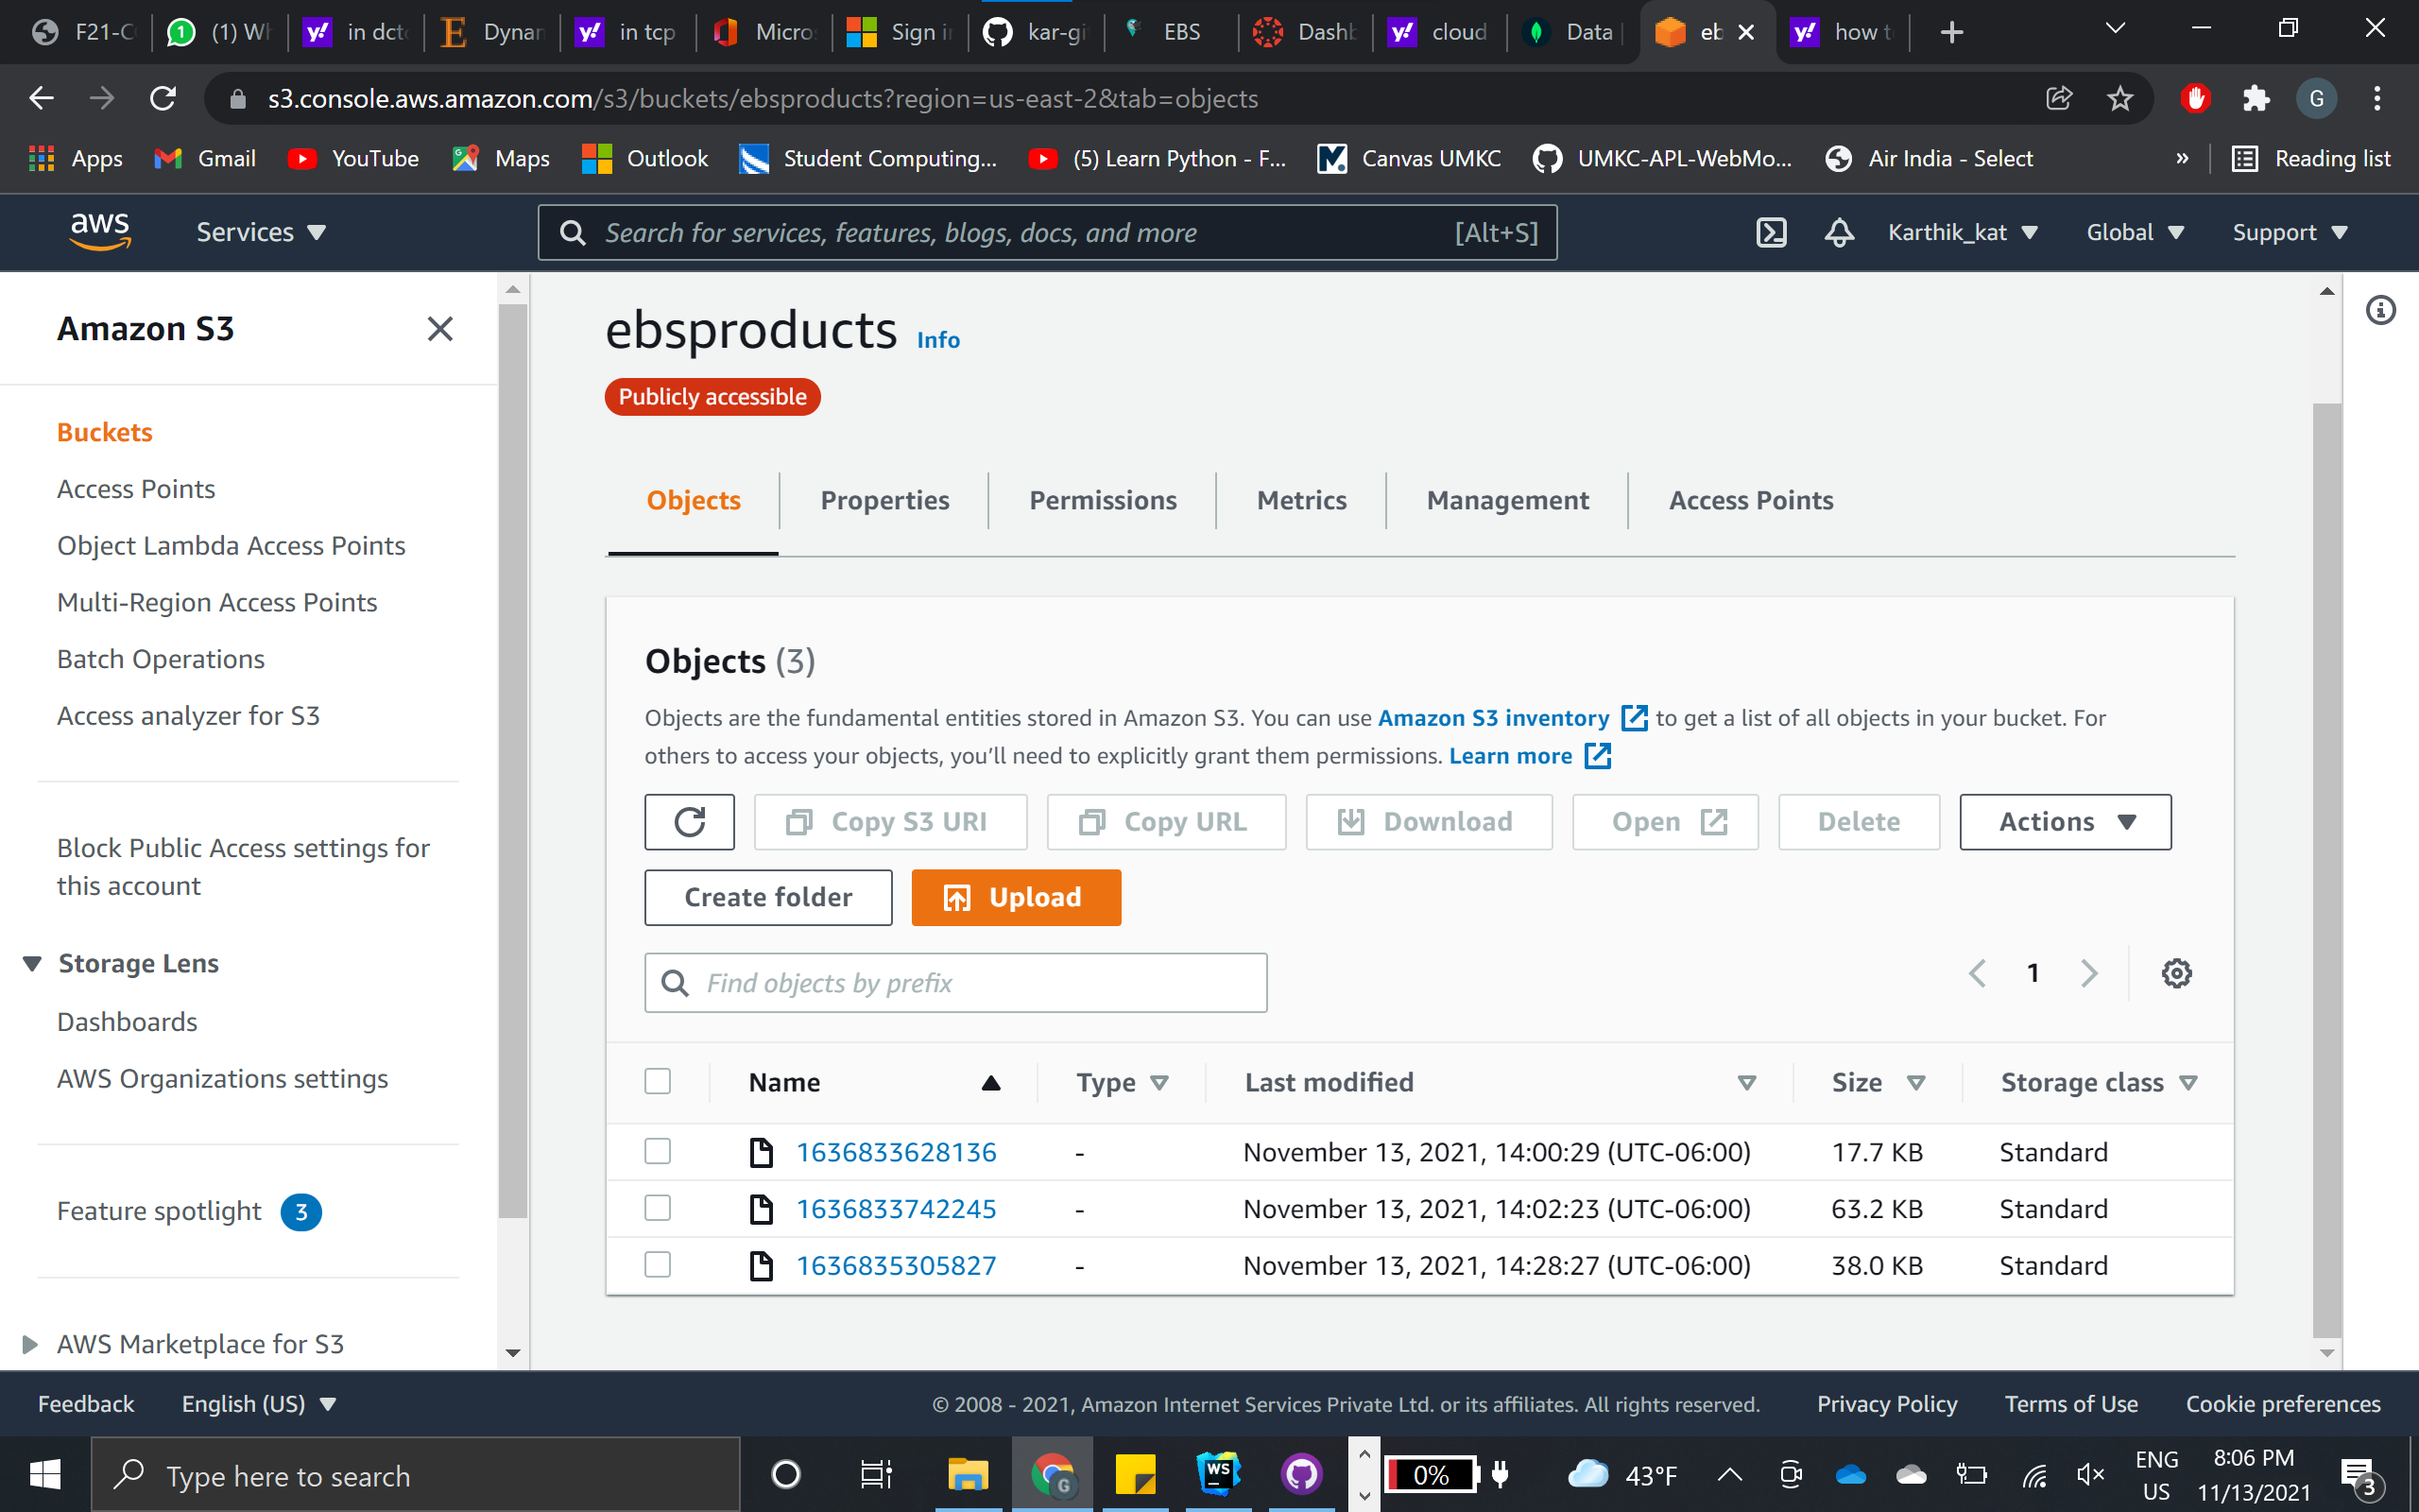
Storage
MongoDB
AWS S3

Slide 15
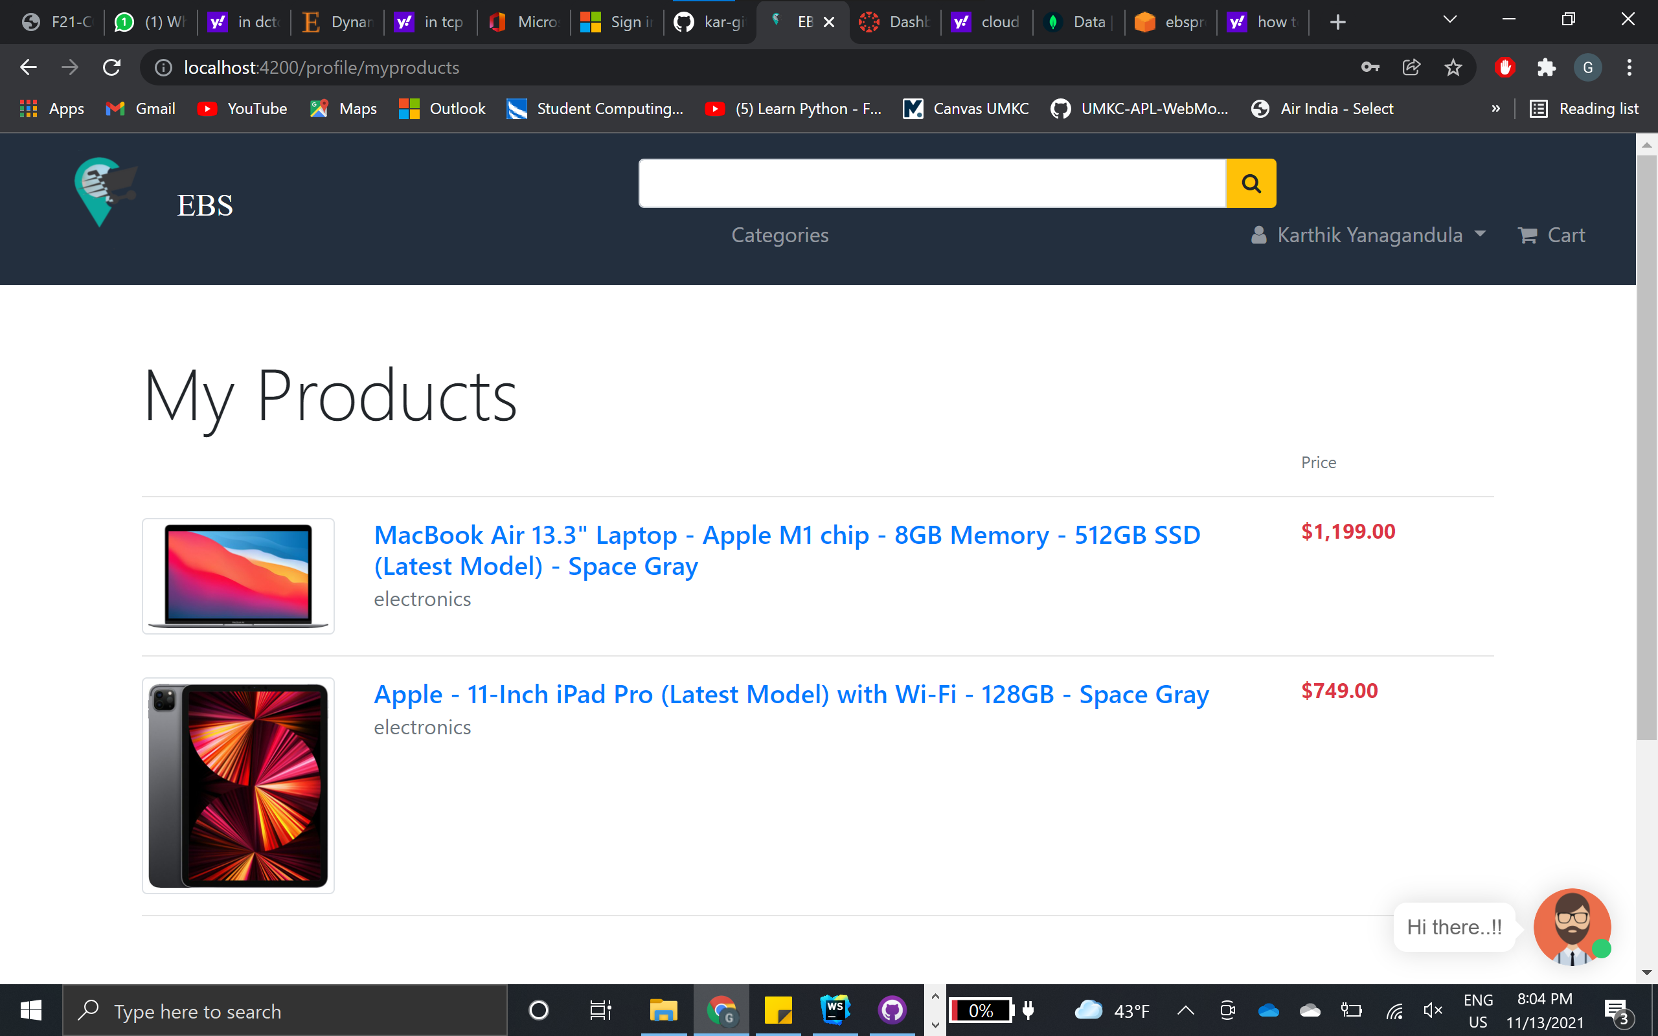
My Products

Slide 16
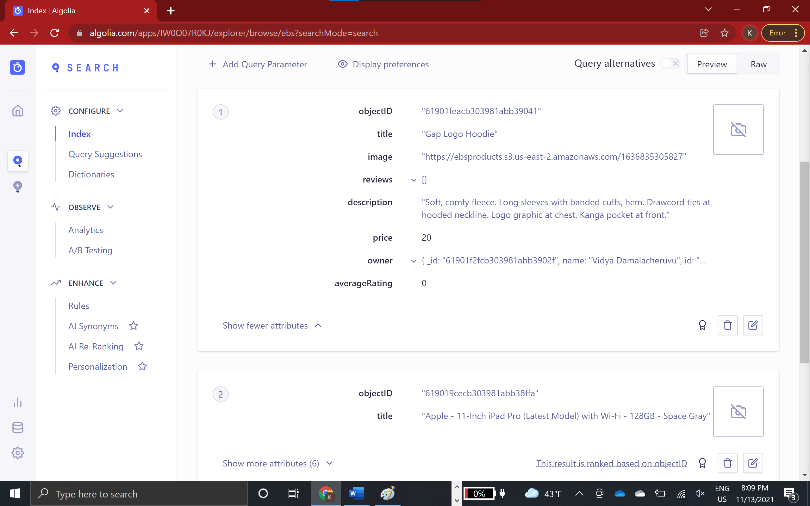
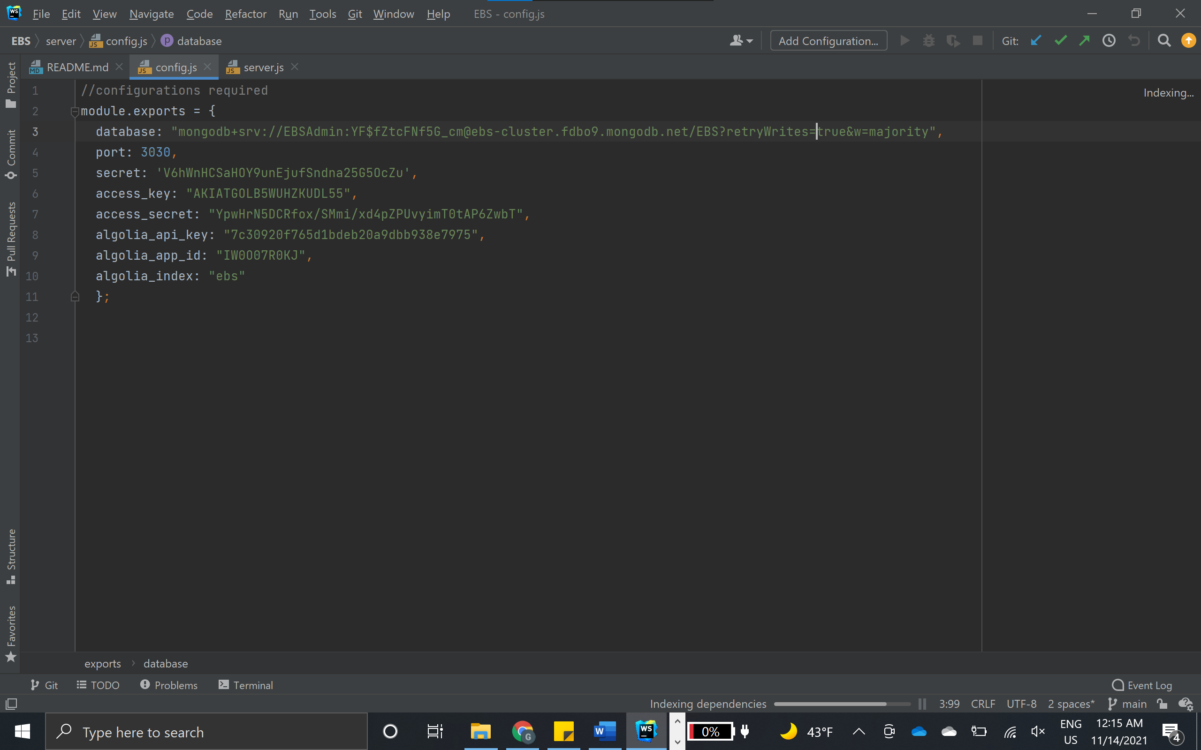
Algolia Search

Slide 17
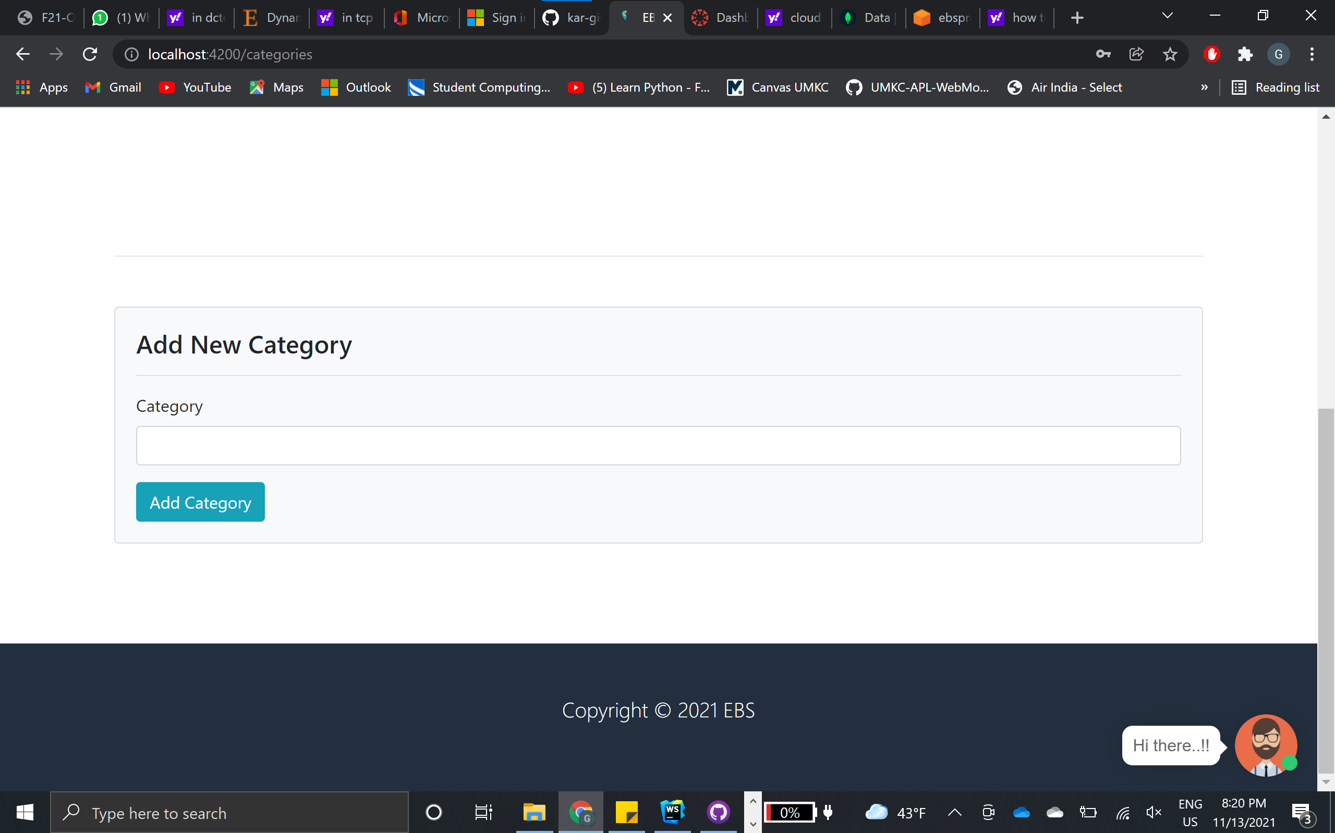
New Category

Slide 18
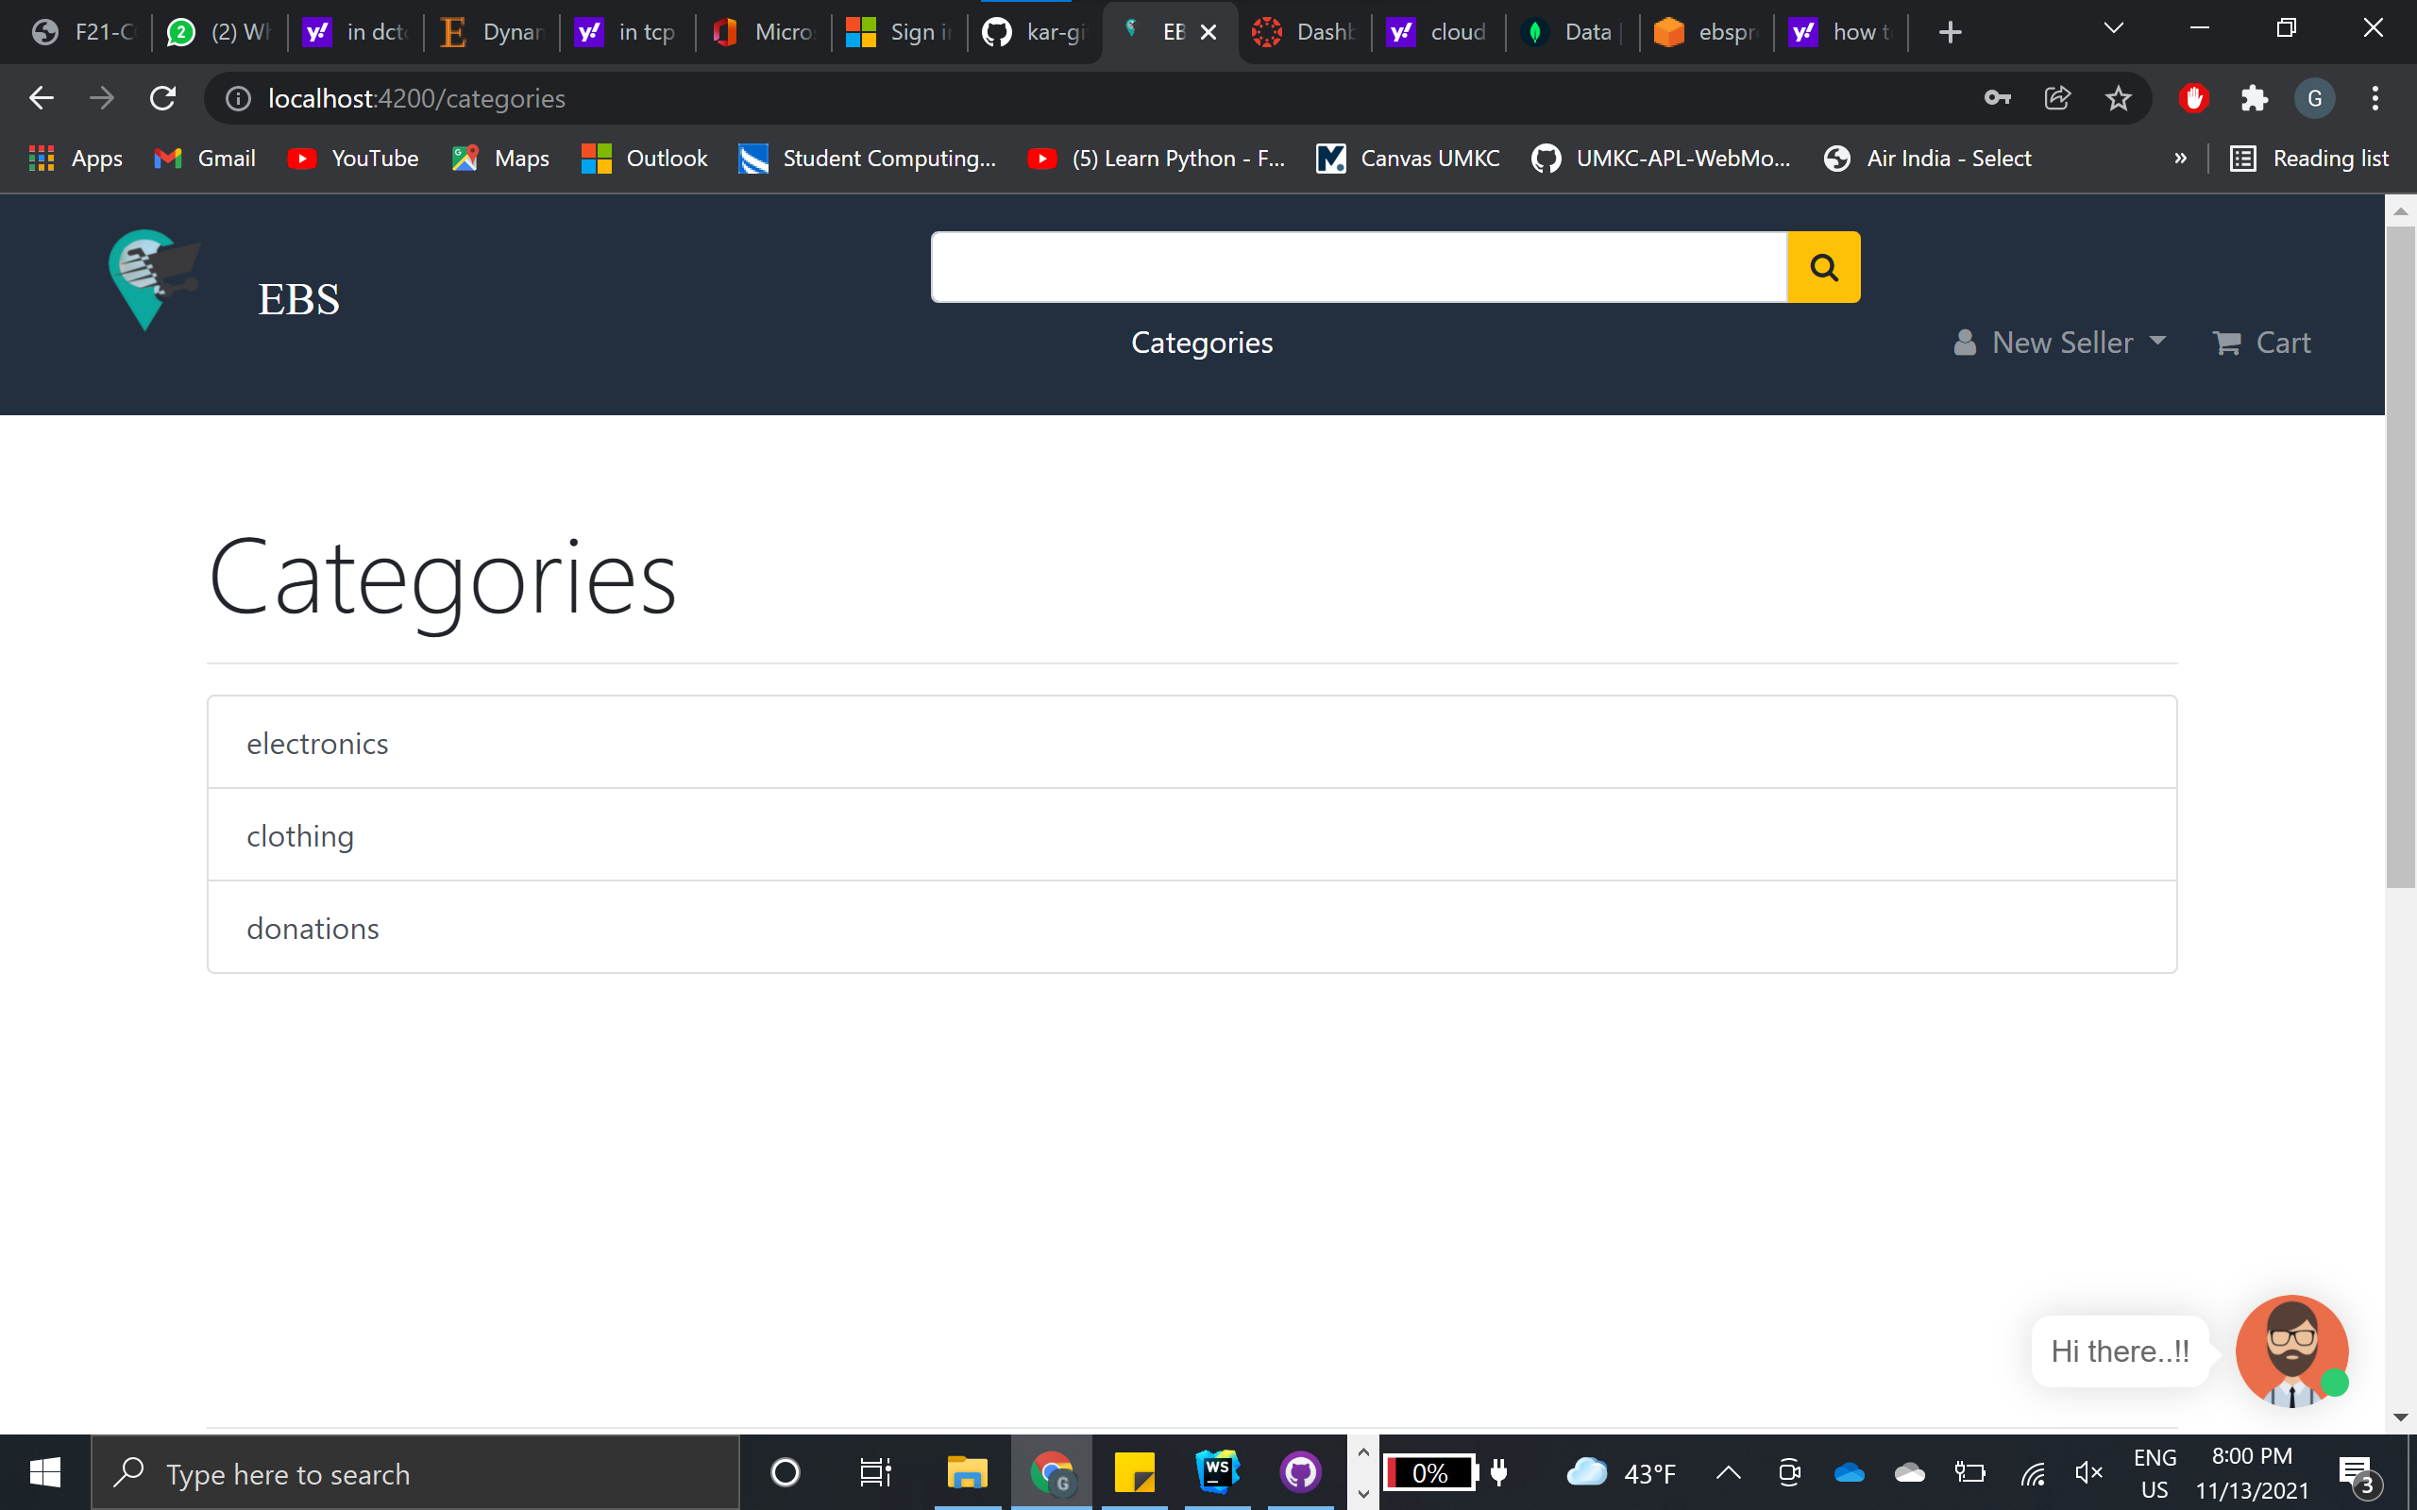
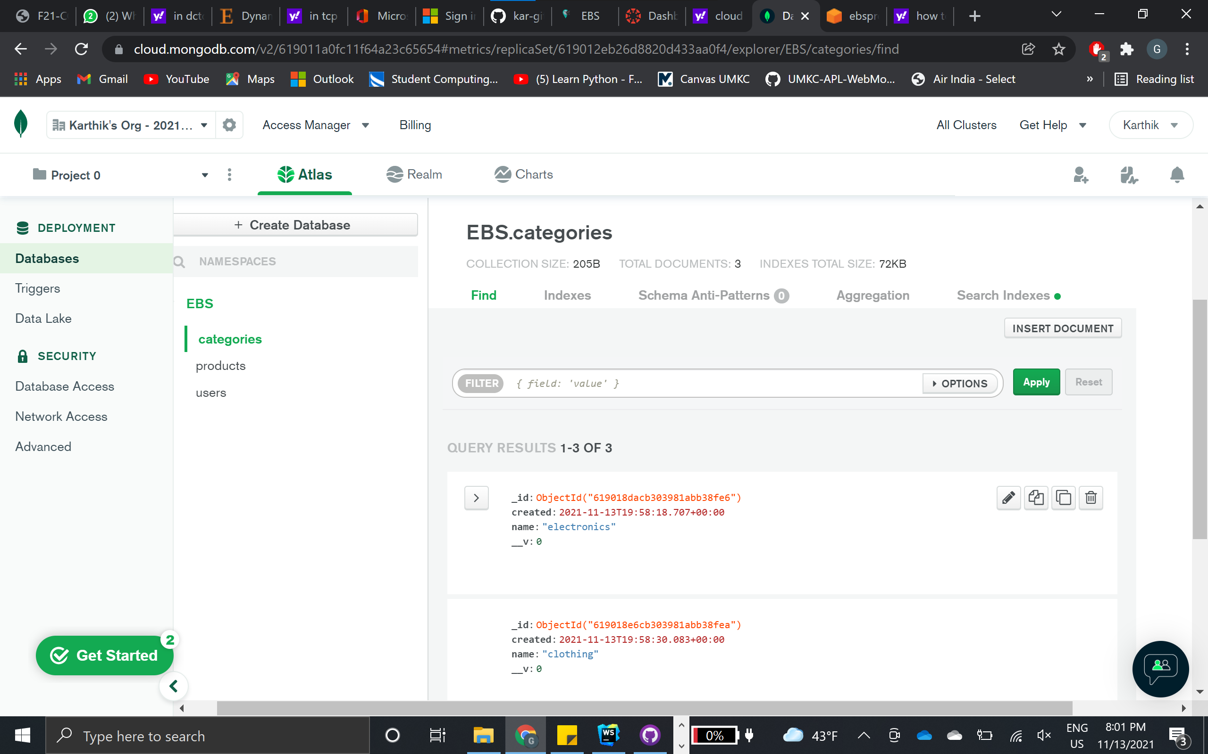
Categories
Application
Database

Slide 19
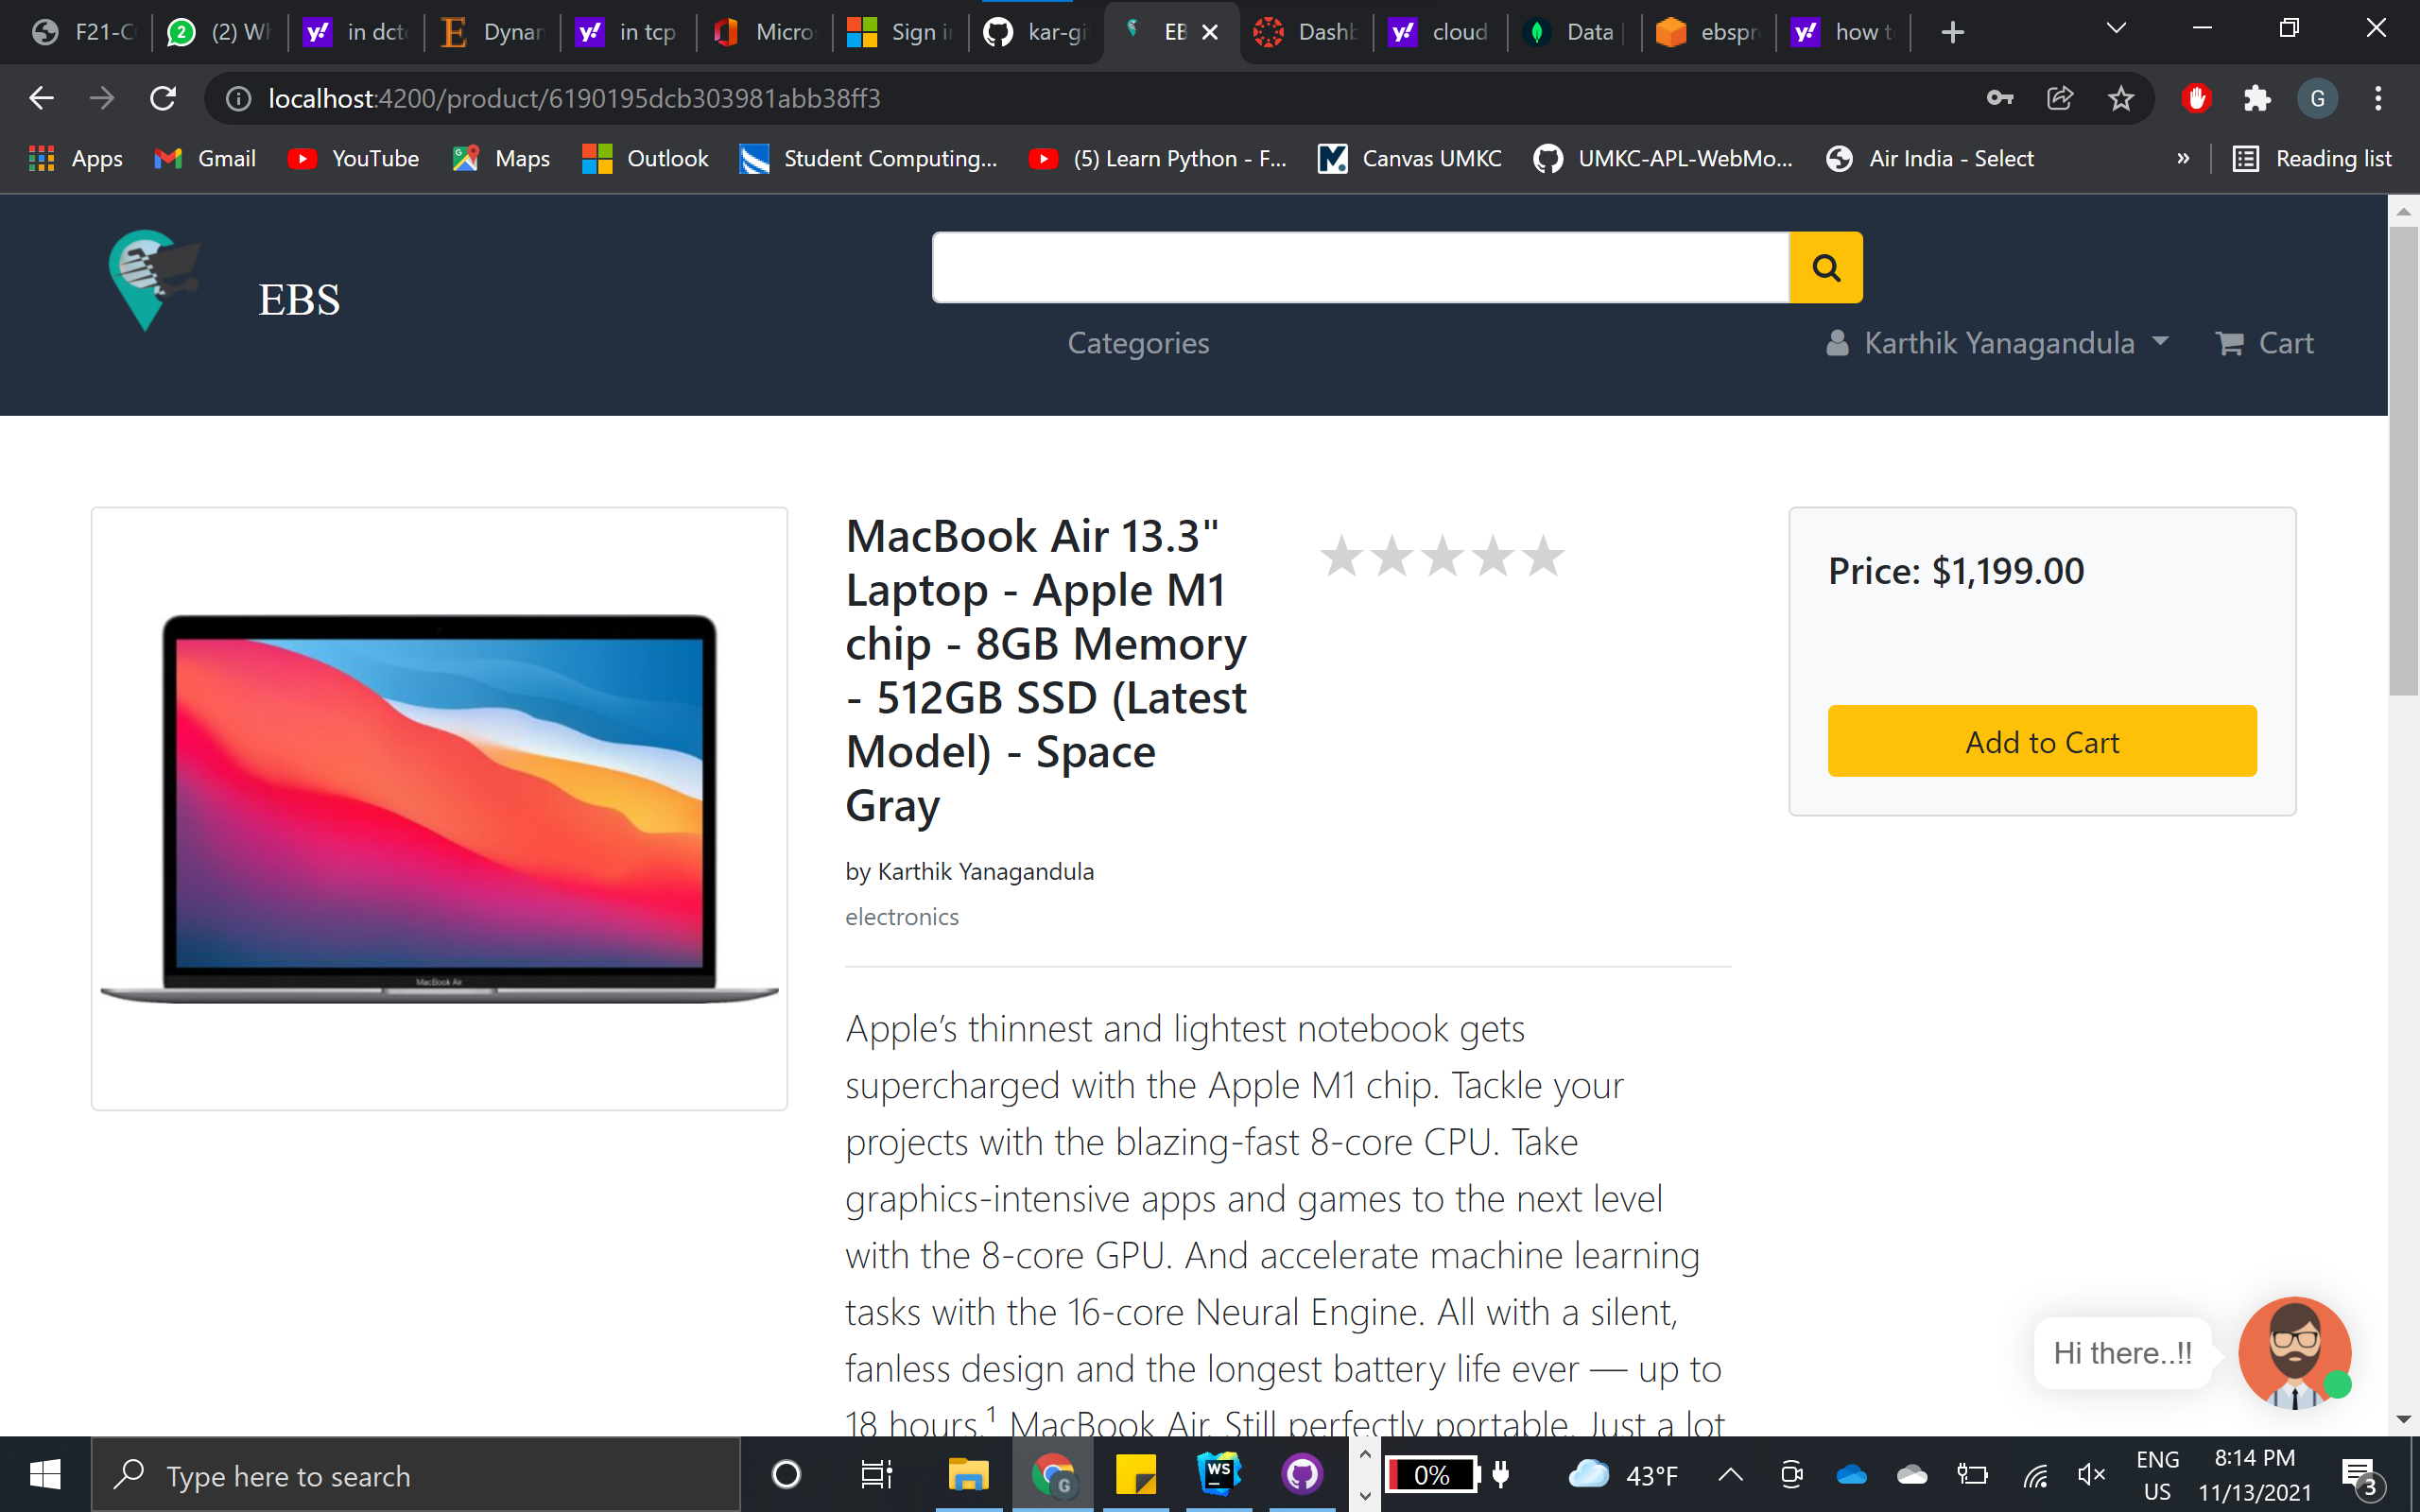
Cart

Slide 20
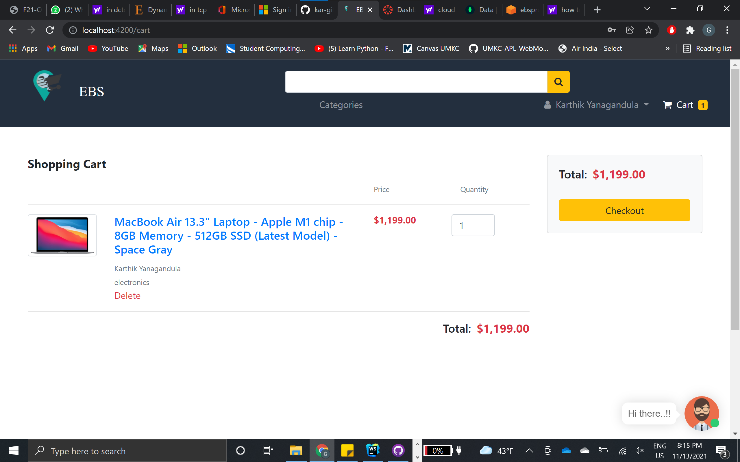
Checkout

Slide 21
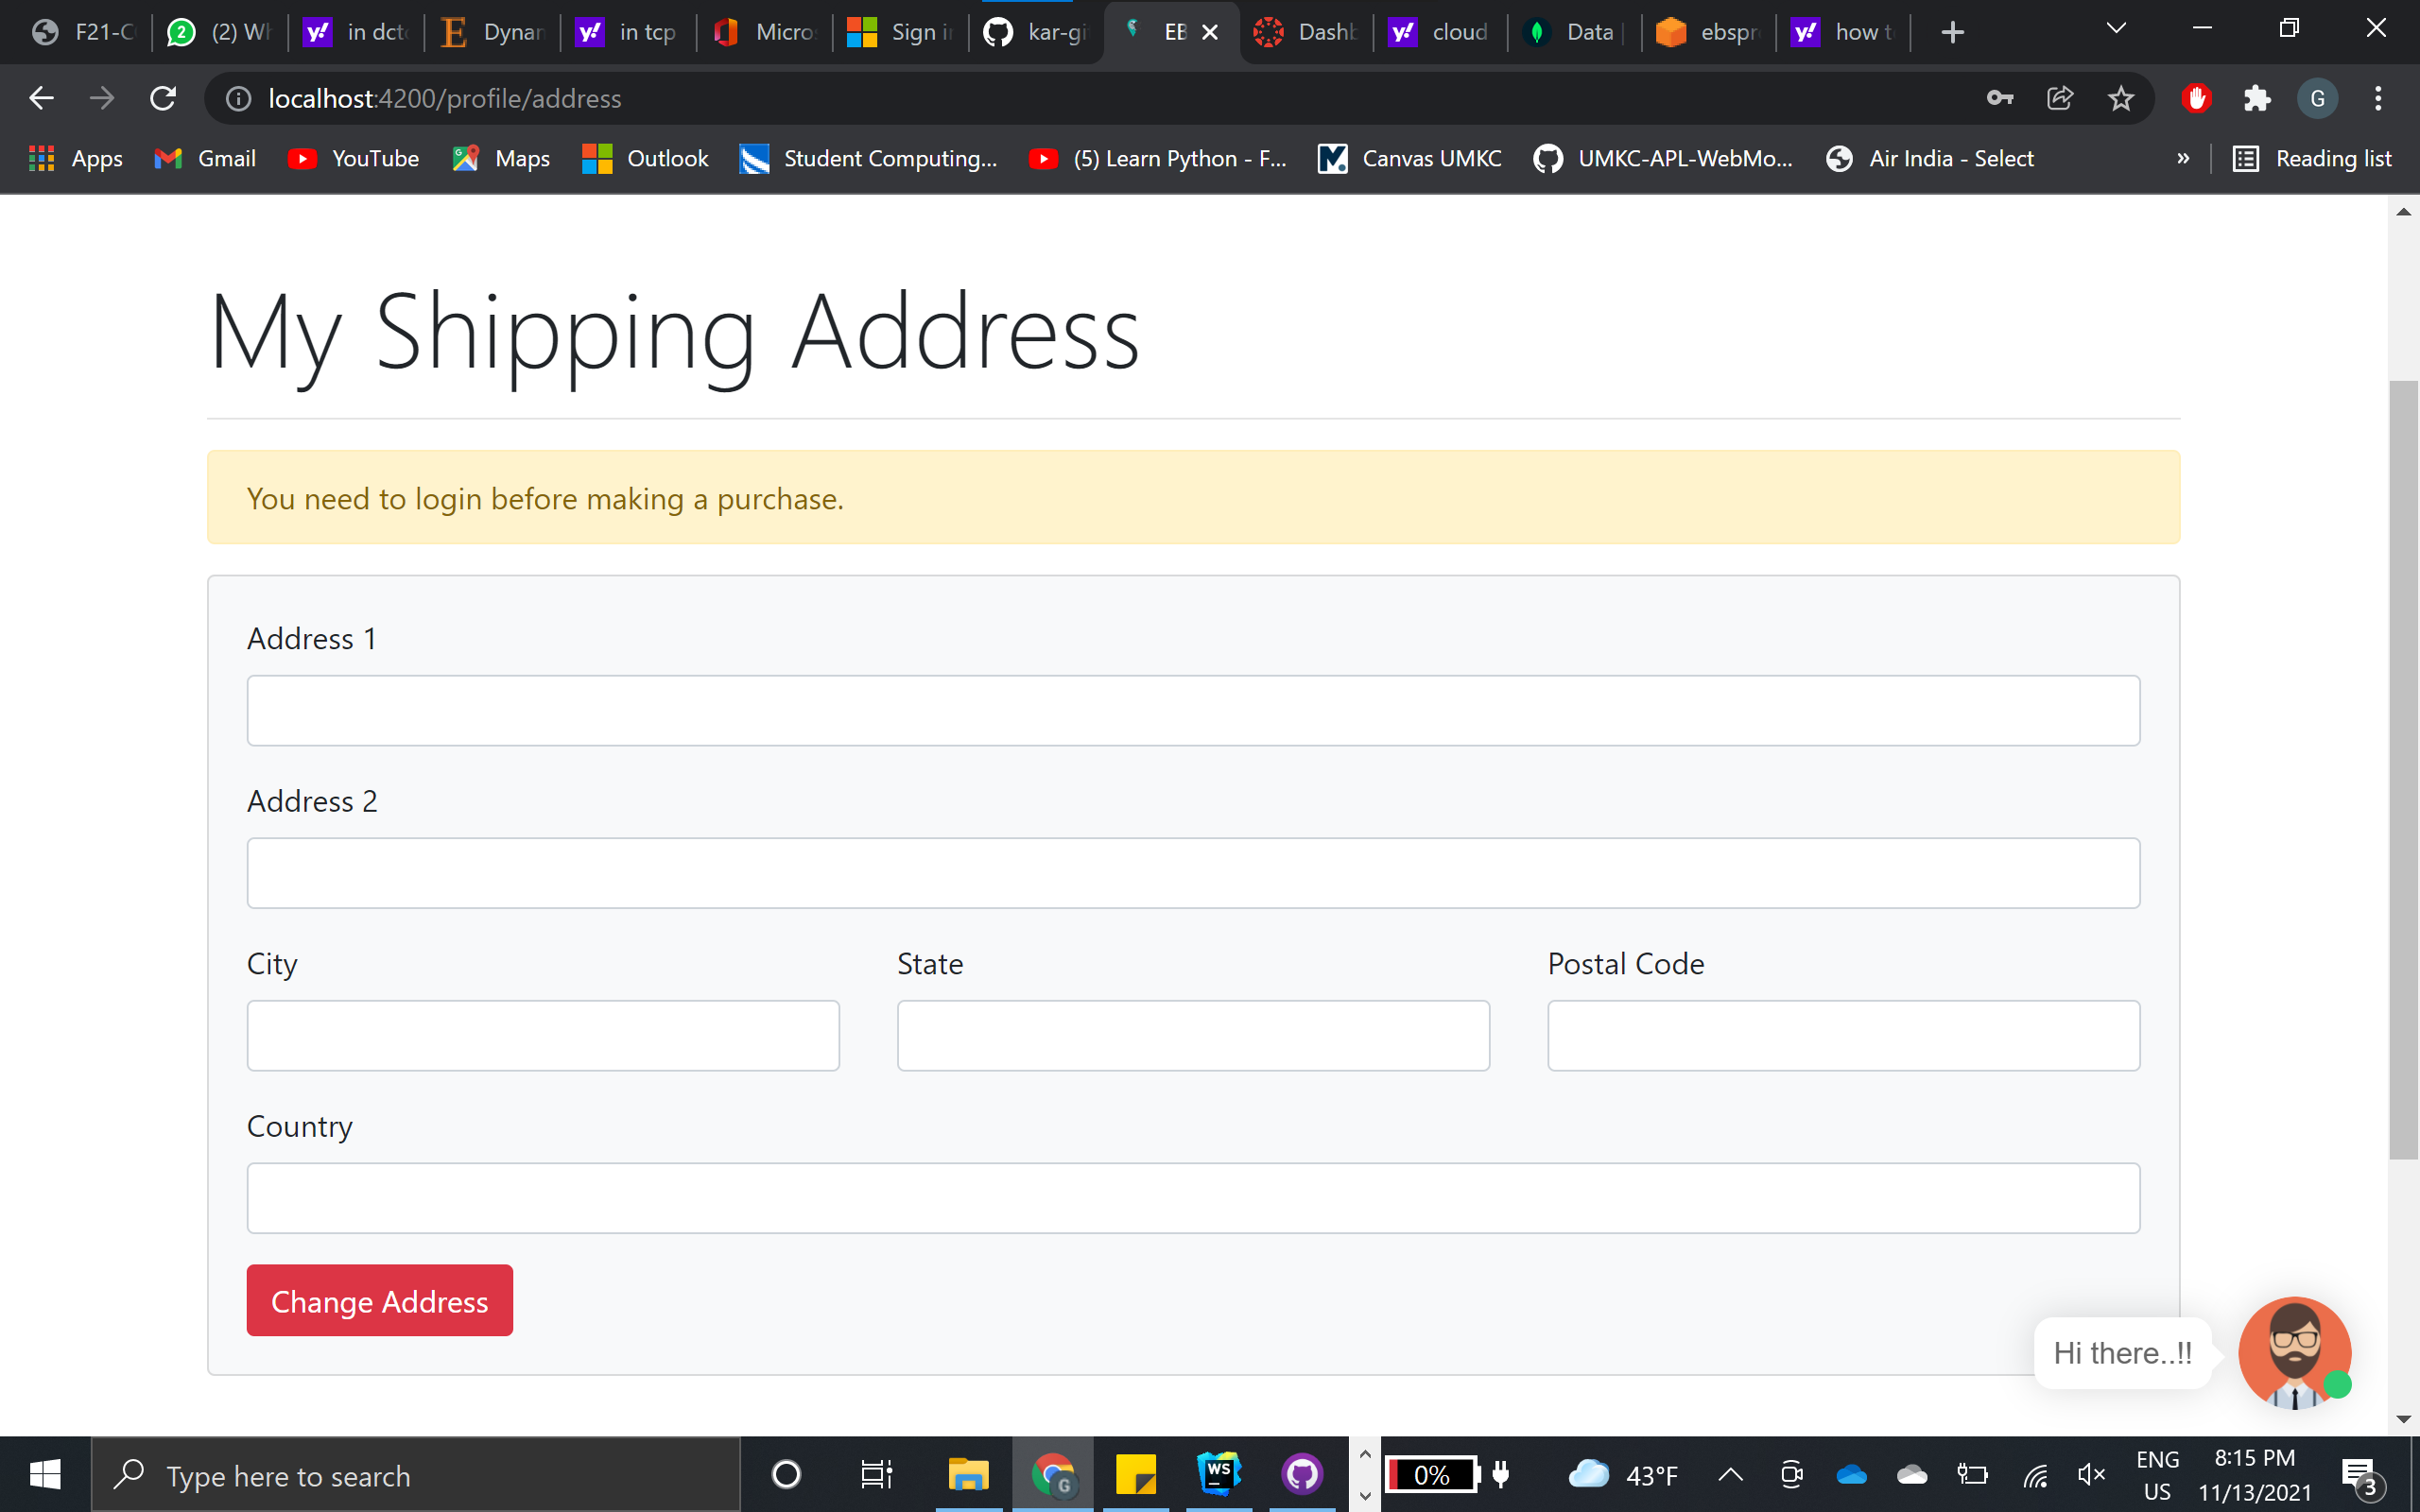
Adding address

Slide 22
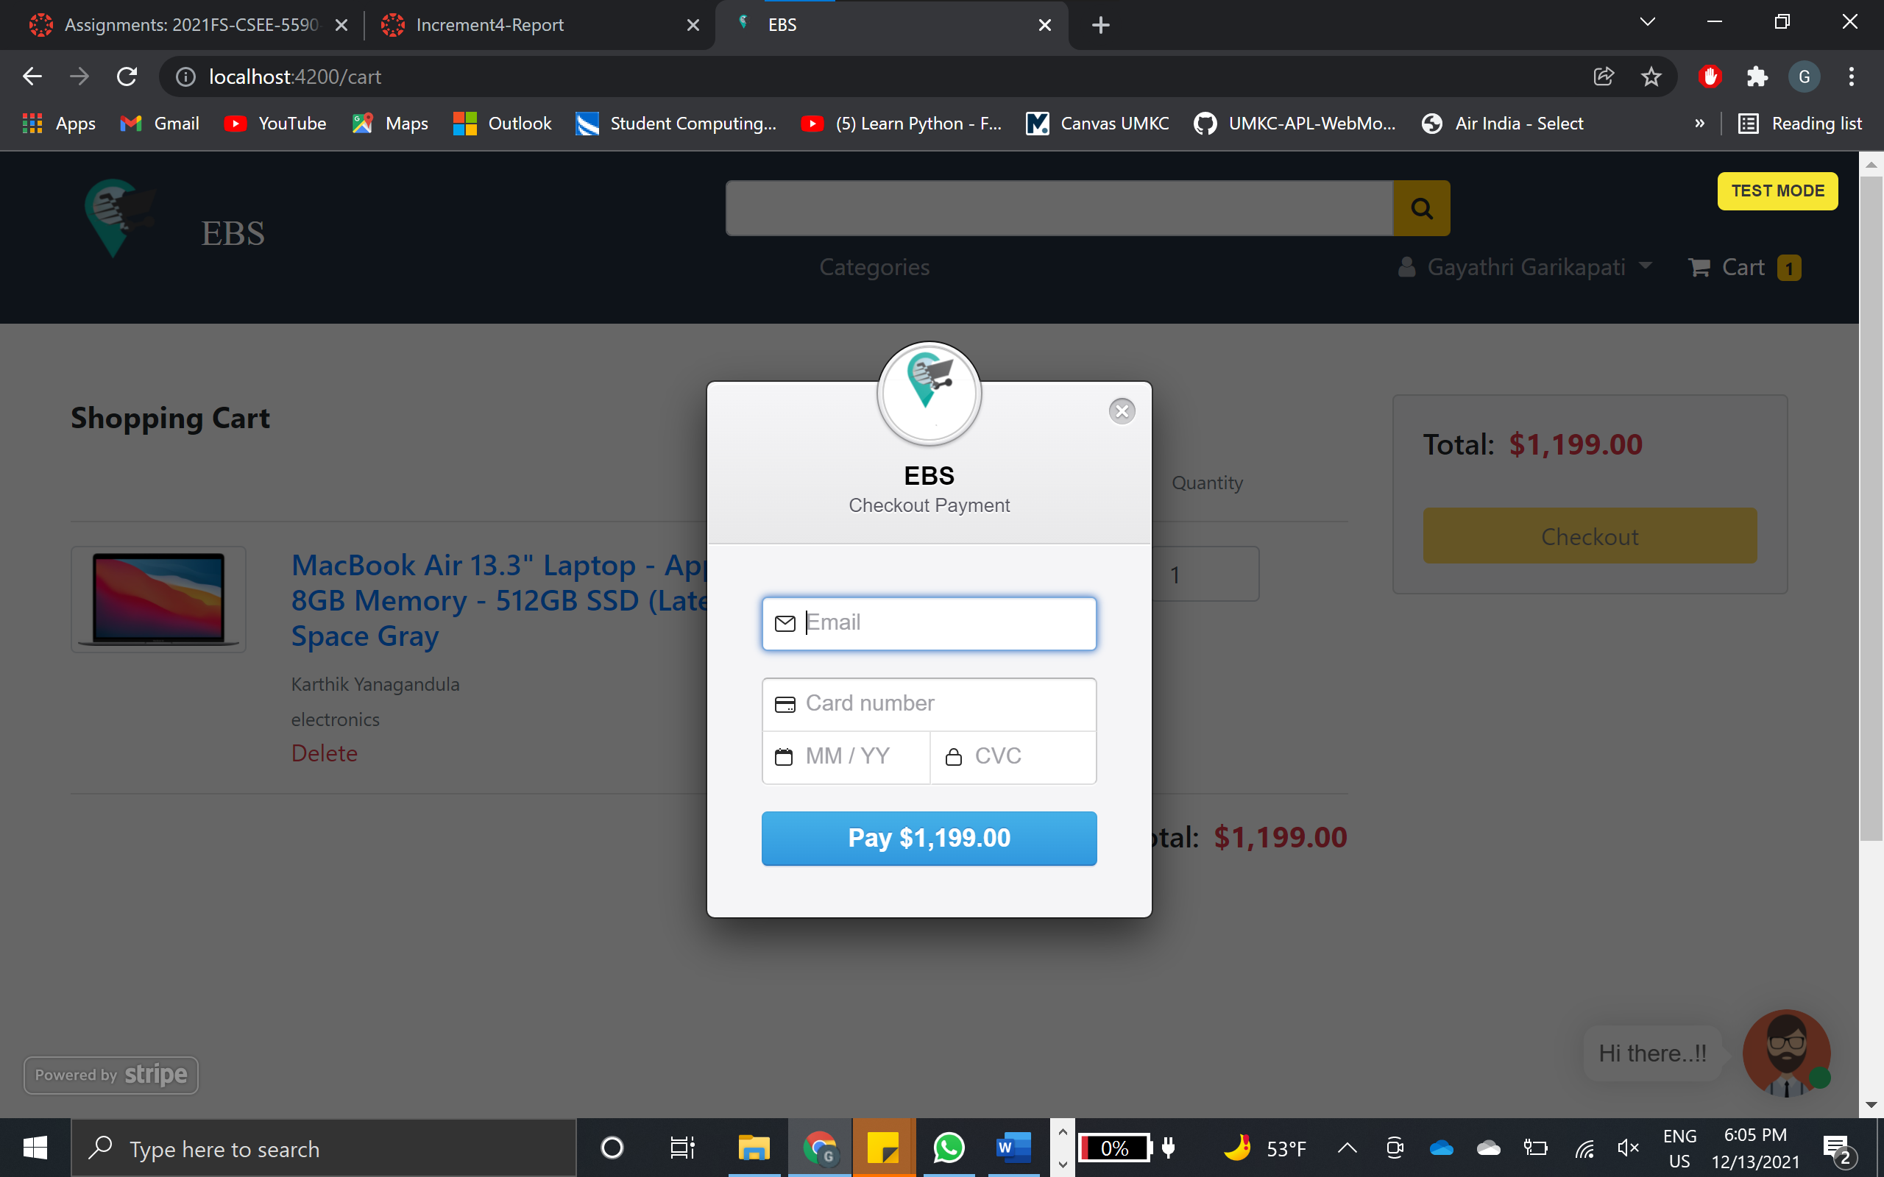
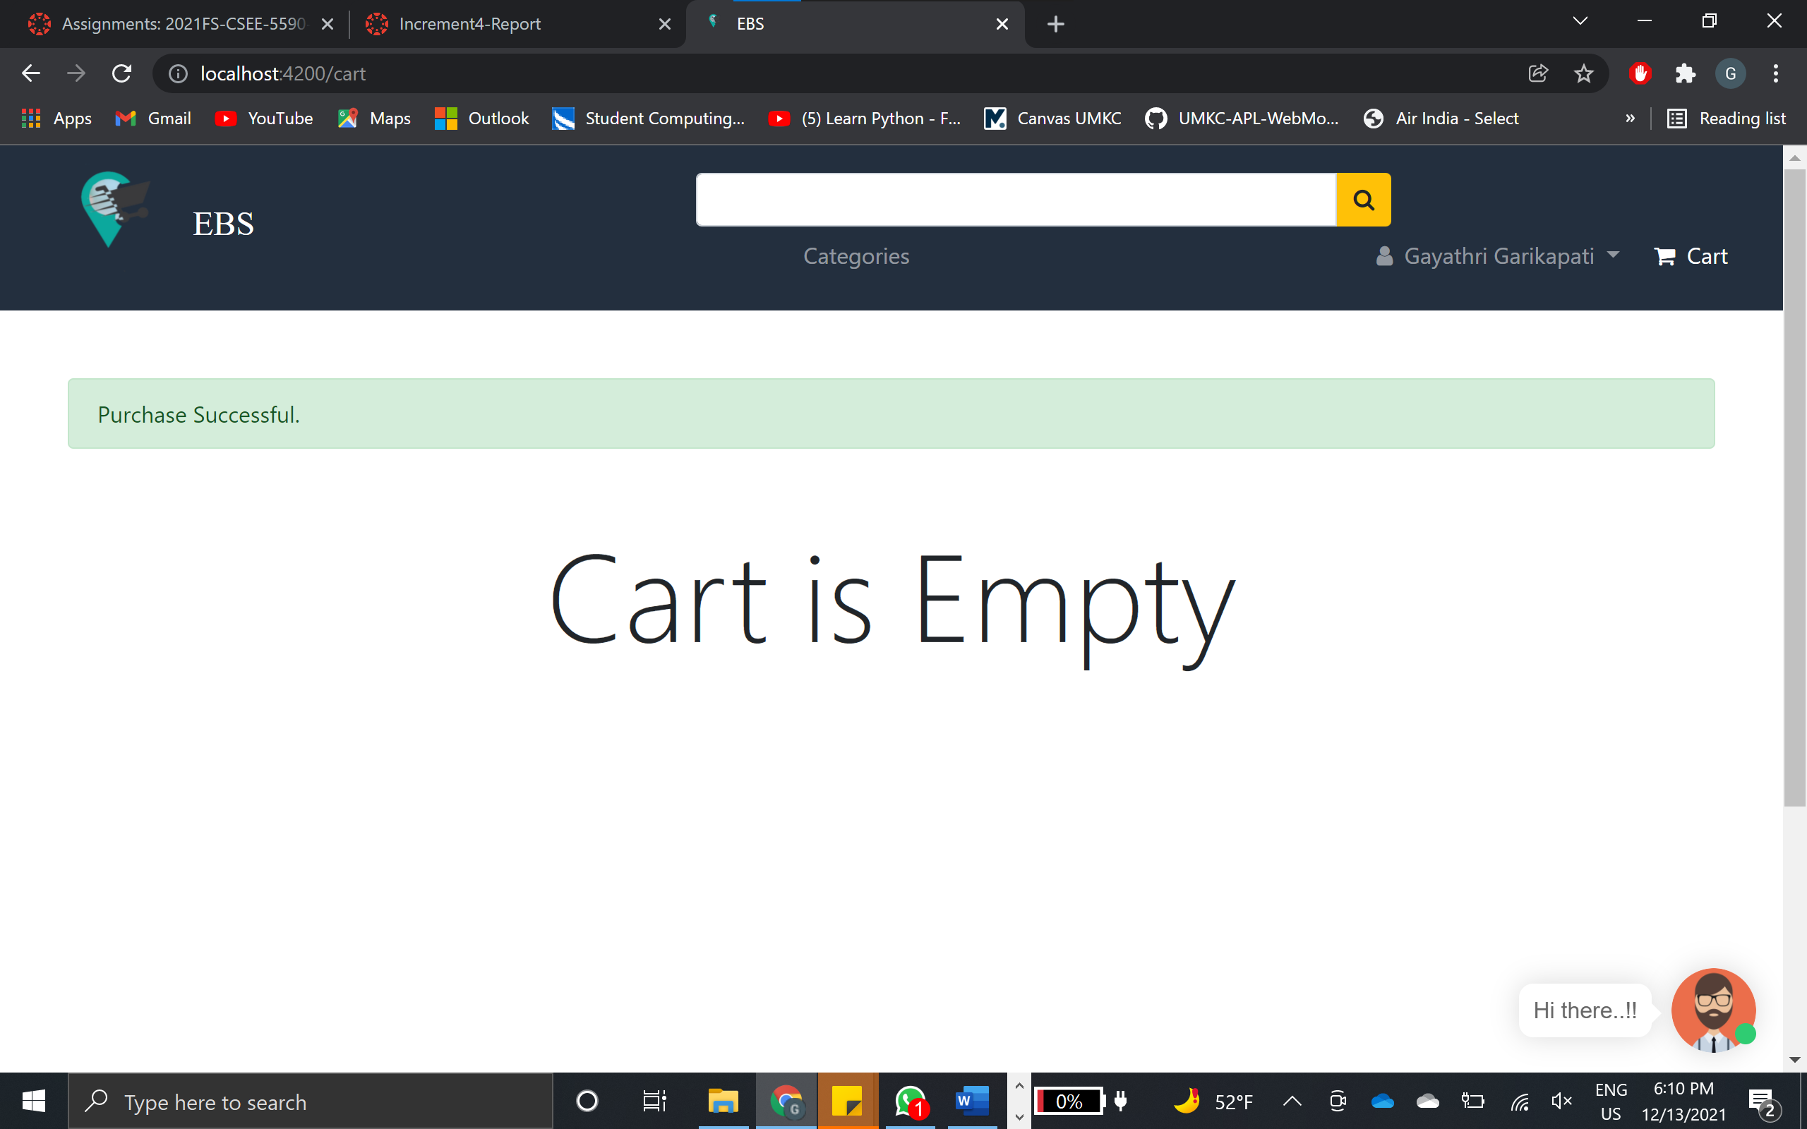
Payment

Slide 23
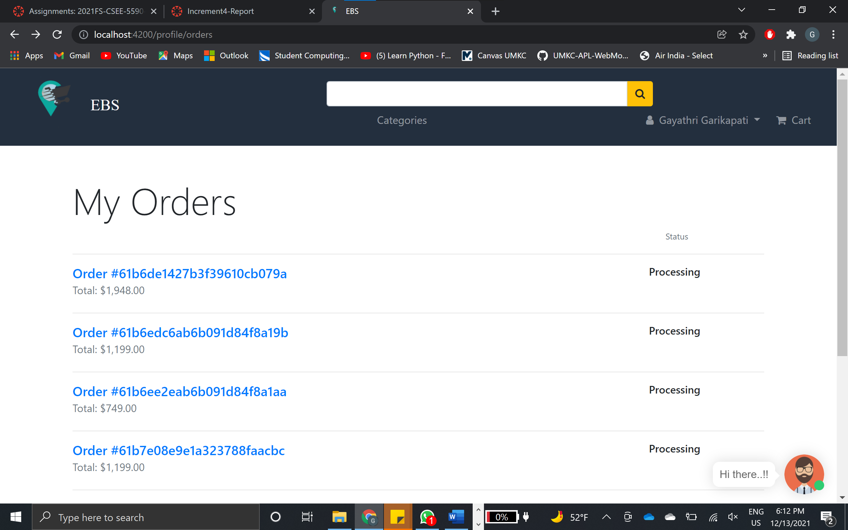
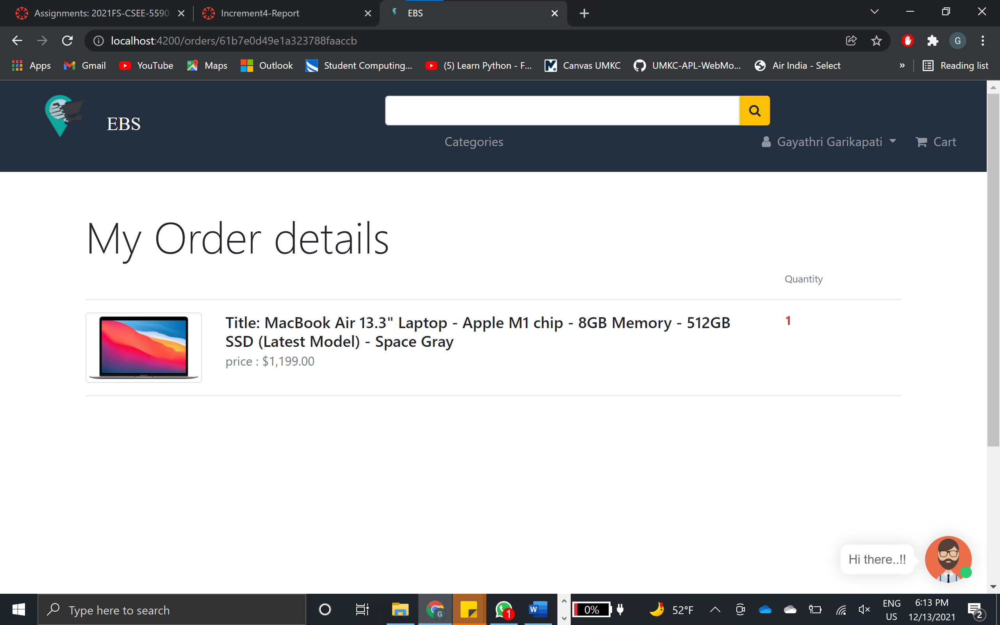
My Orders

Slide 24
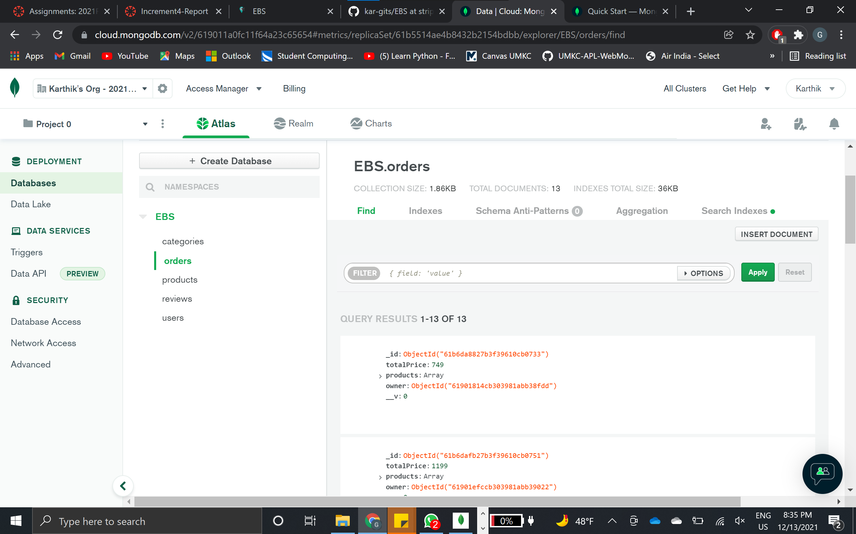
Orders Data

Slide 25
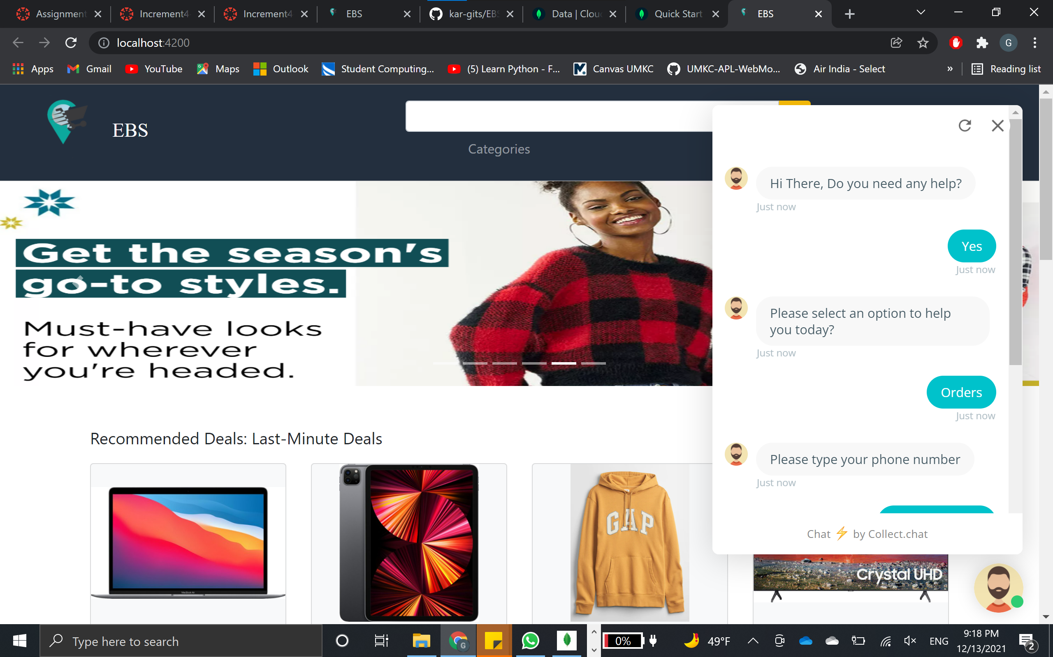
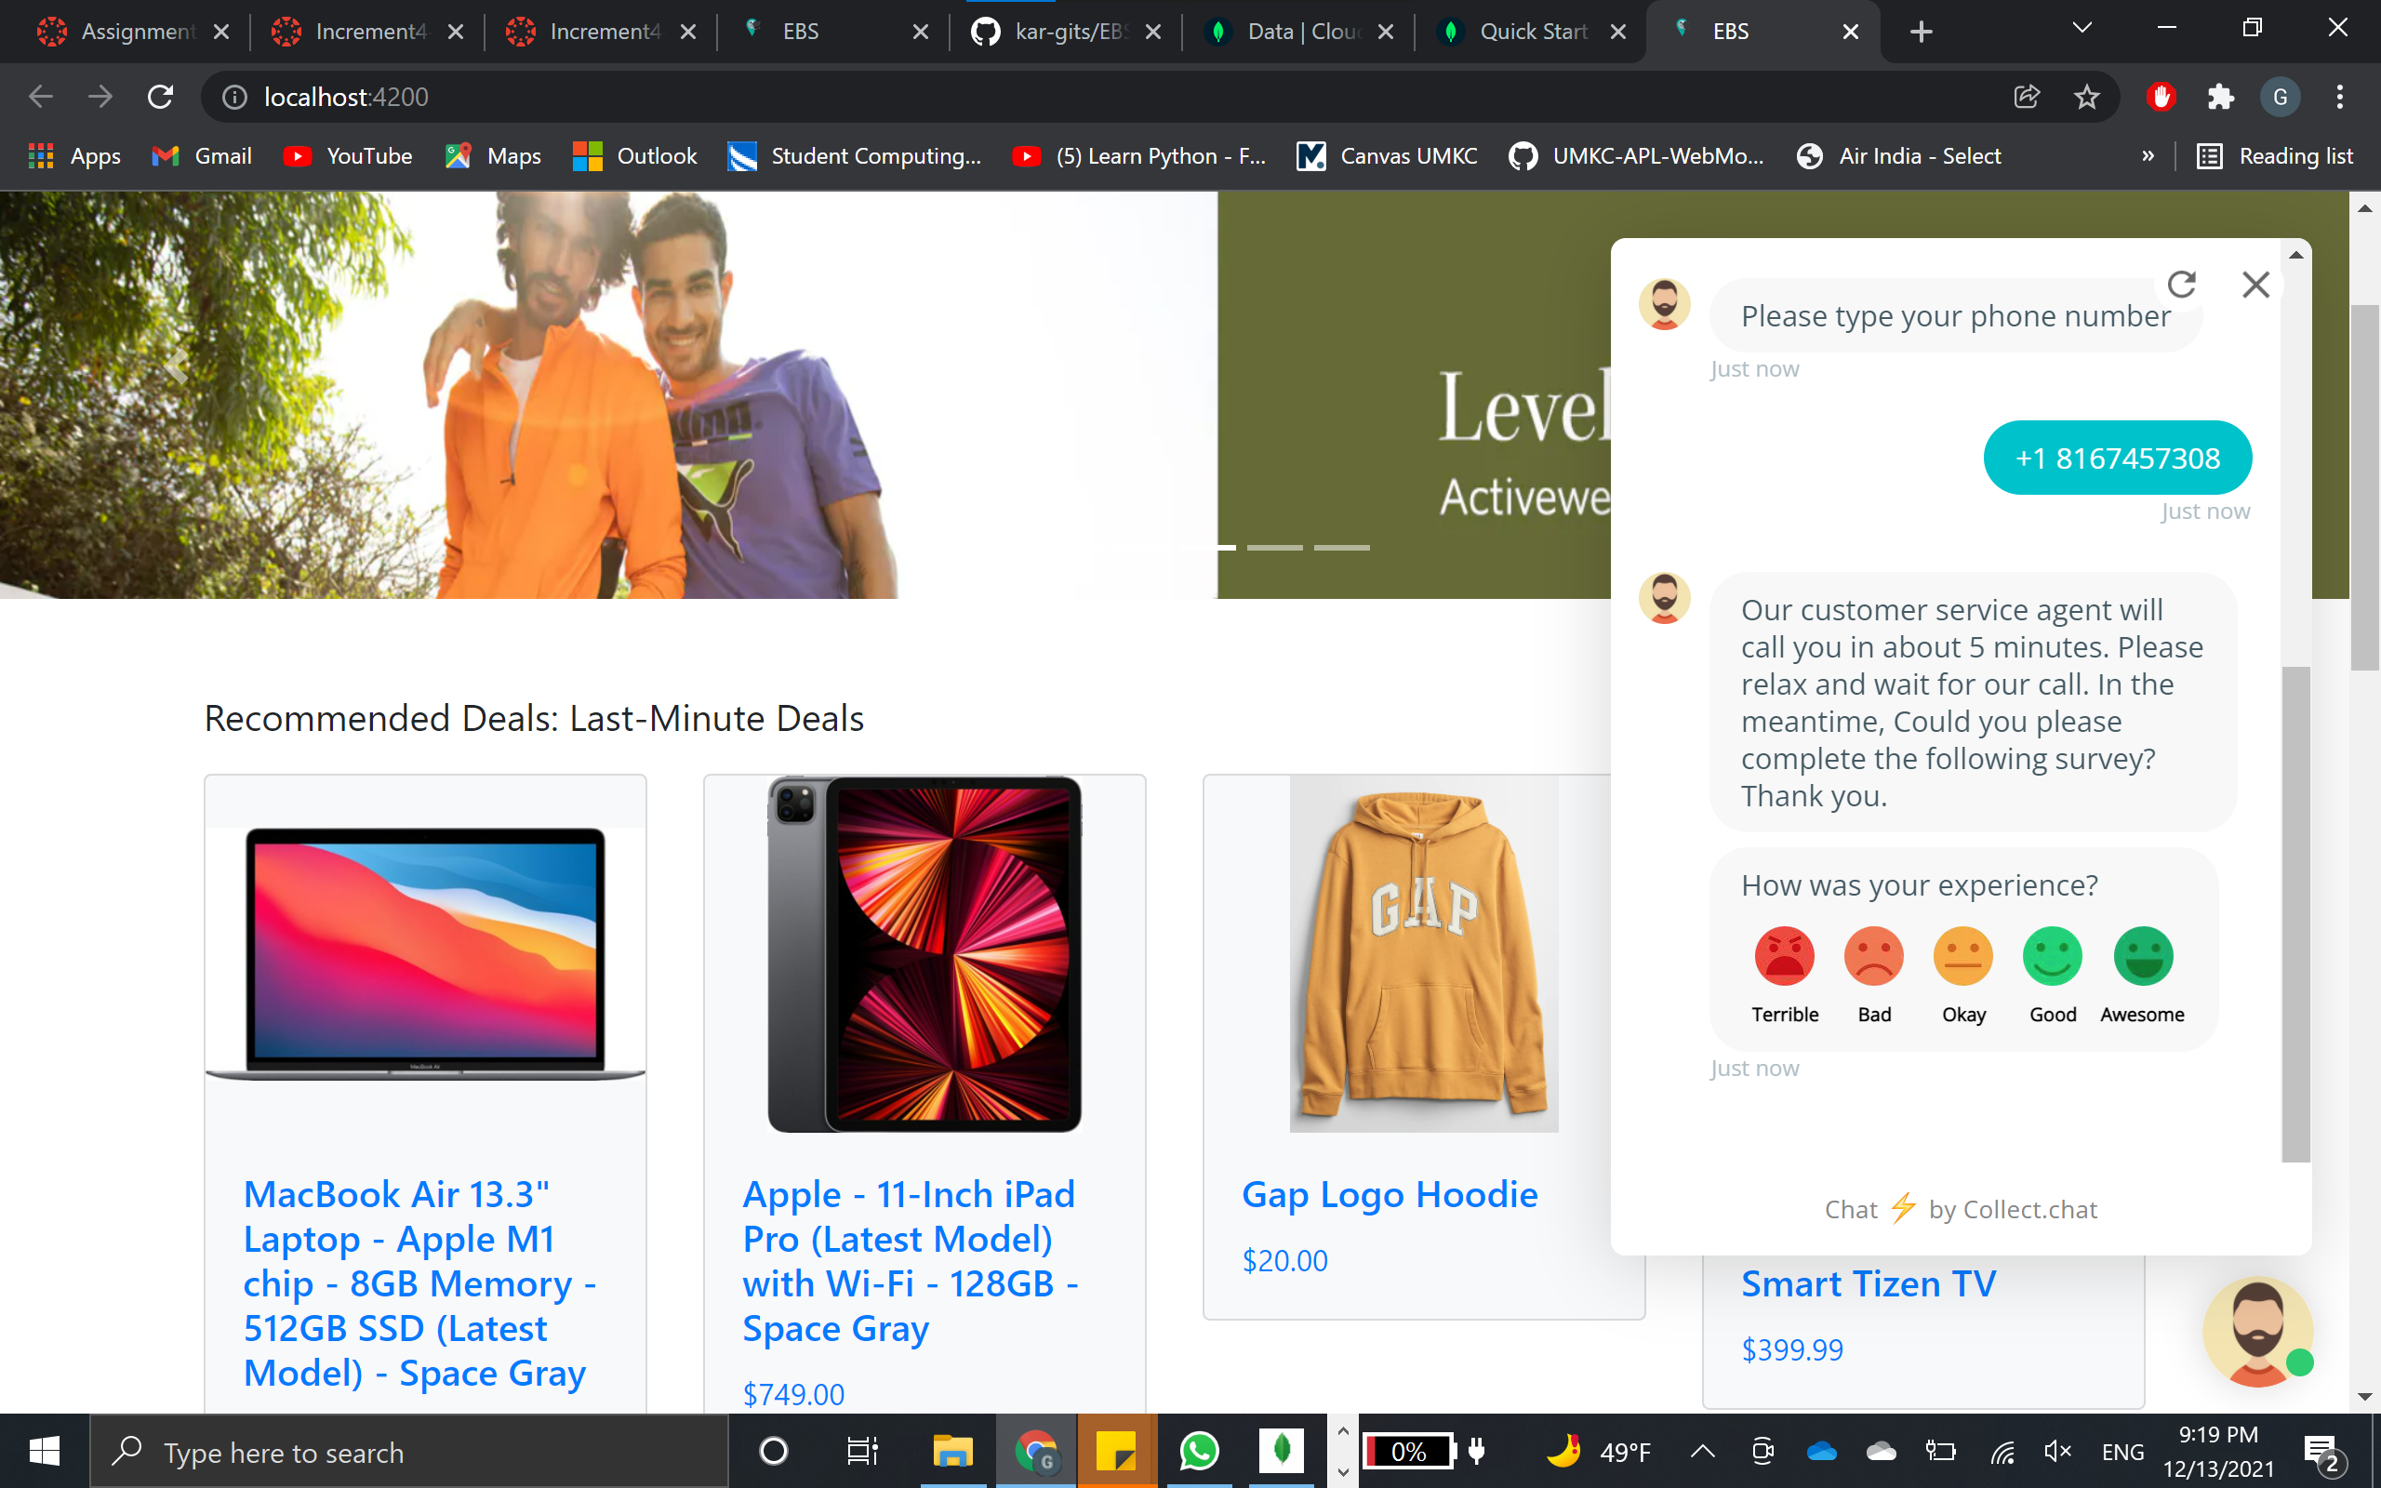
ChatBot

Slide 26
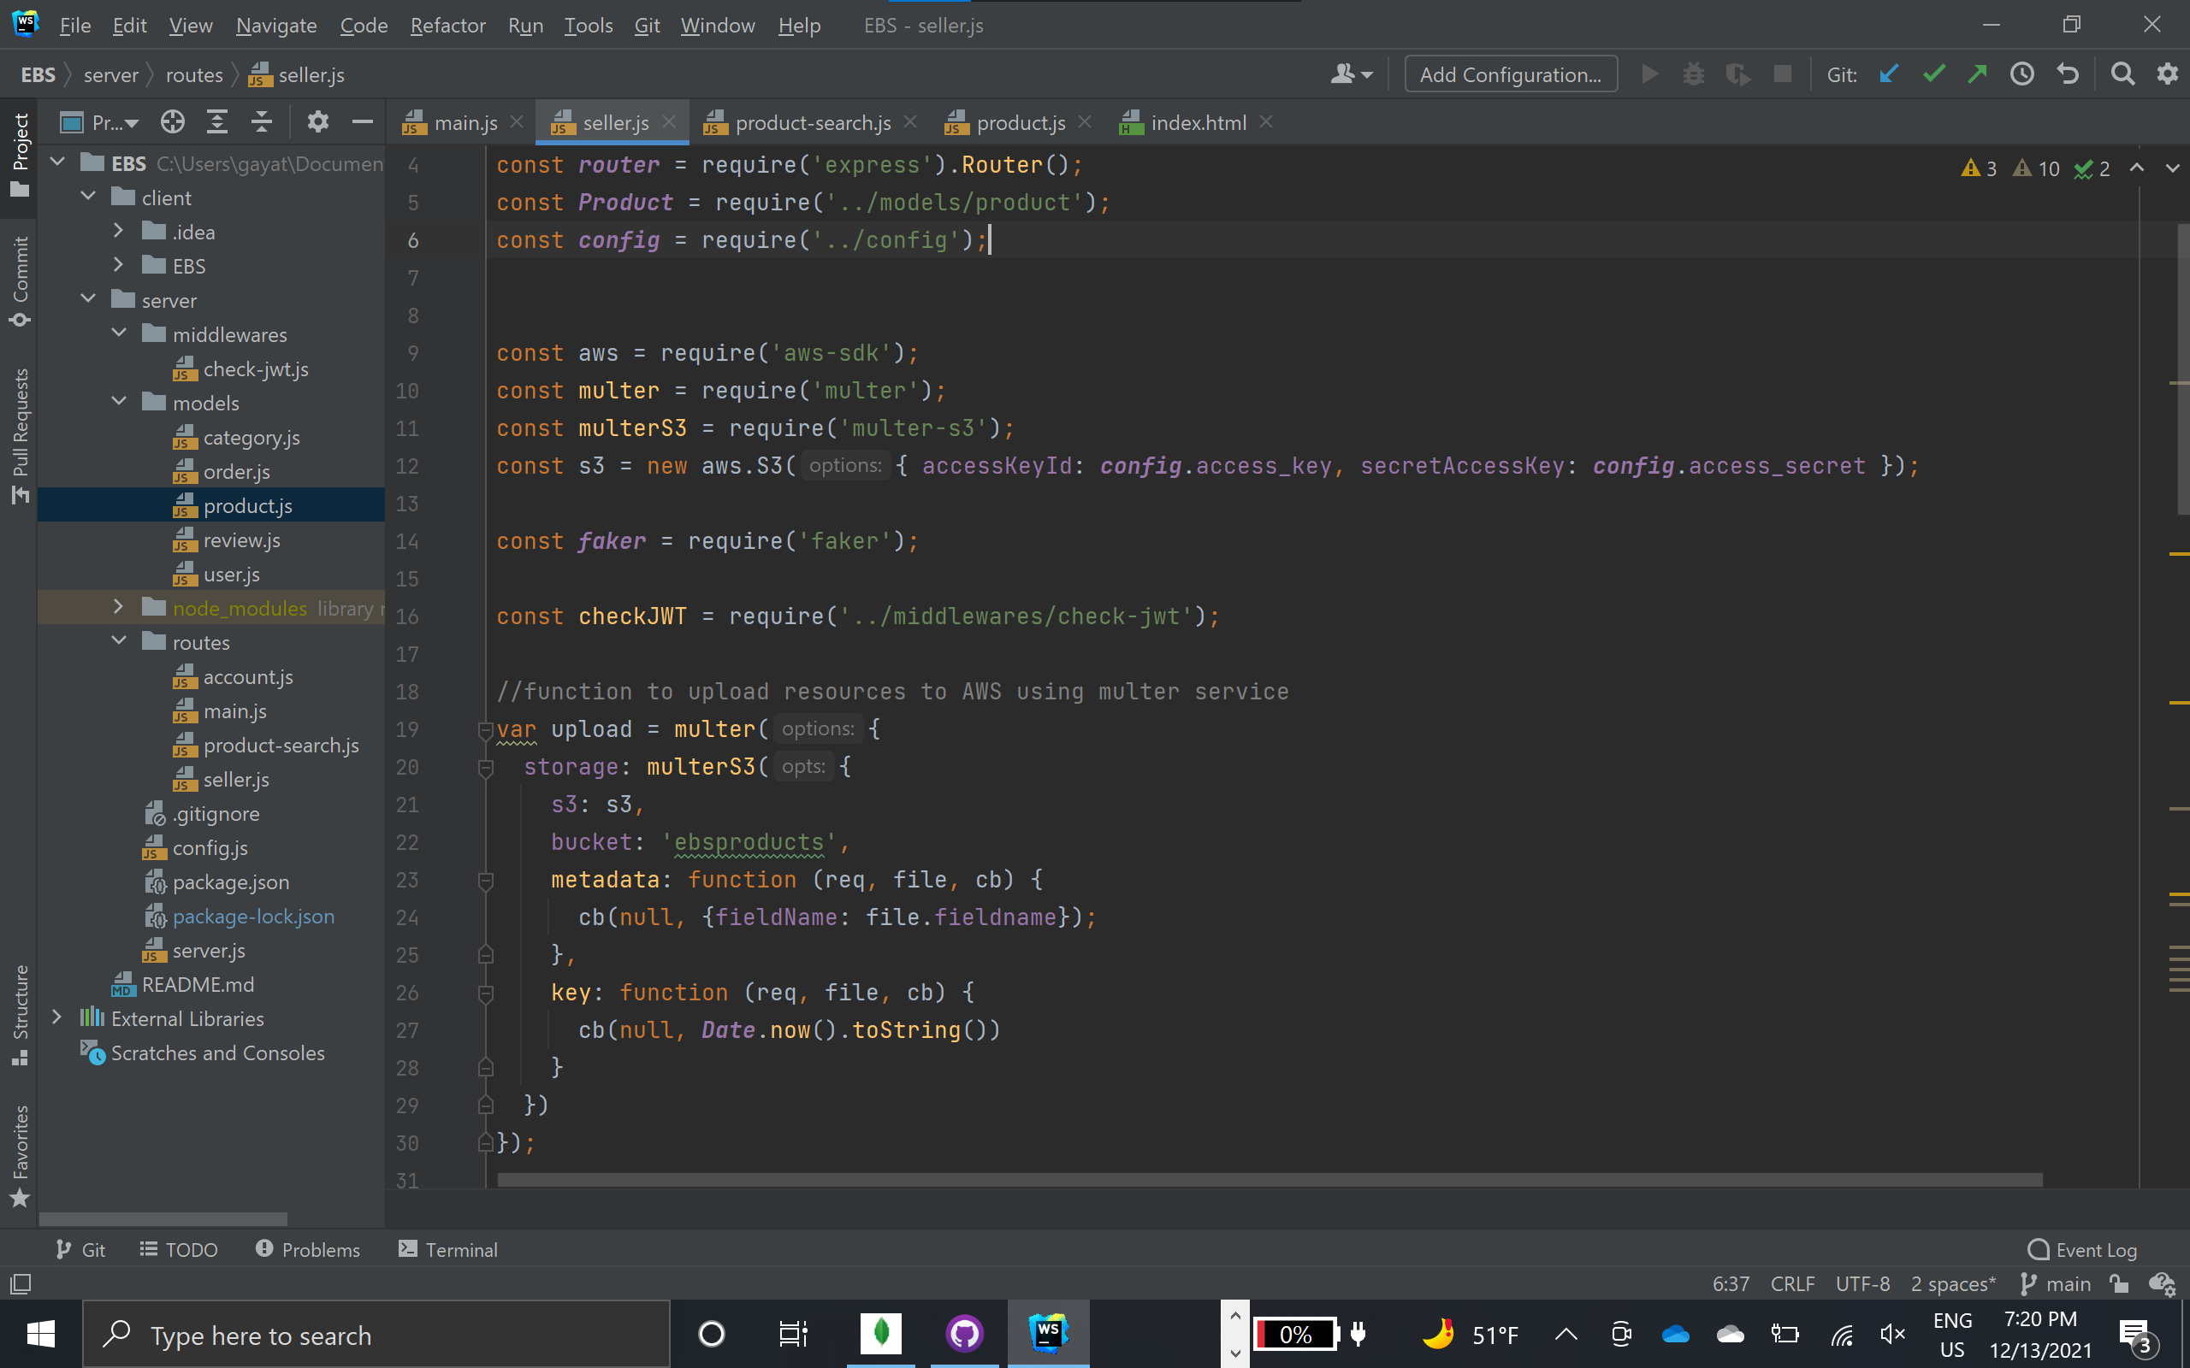
Seller.js
To maintain all product details and store the resources like images on AWS S3. We used mutler to connect to AWS S3 using secret keys.

Slide 27
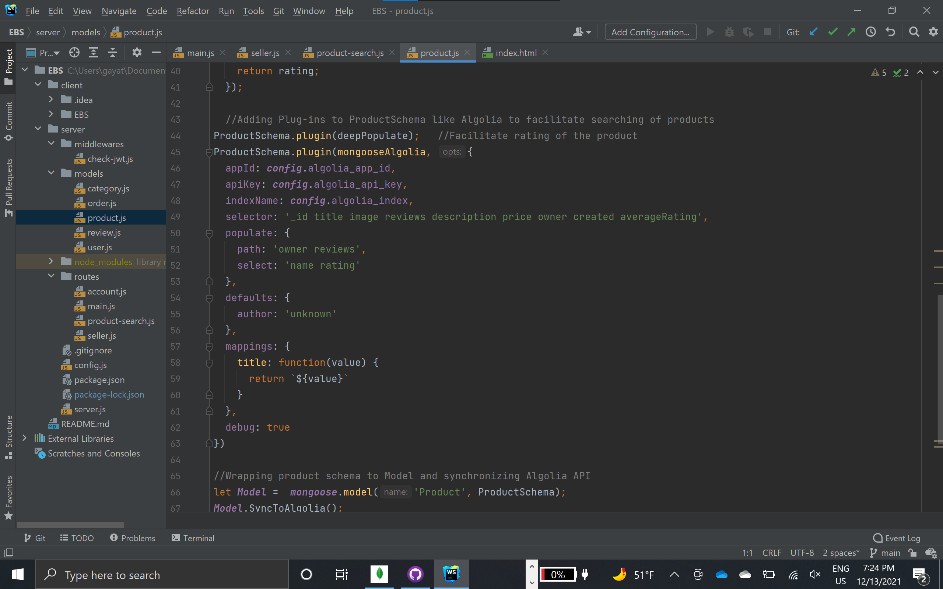
Product.js
Using mongoose-algolia, we connected Algolia API to product schema, which loads the product data to Algolia search API. This ensures that all the product details in application are shared with API to perform search operations.

Slide 28
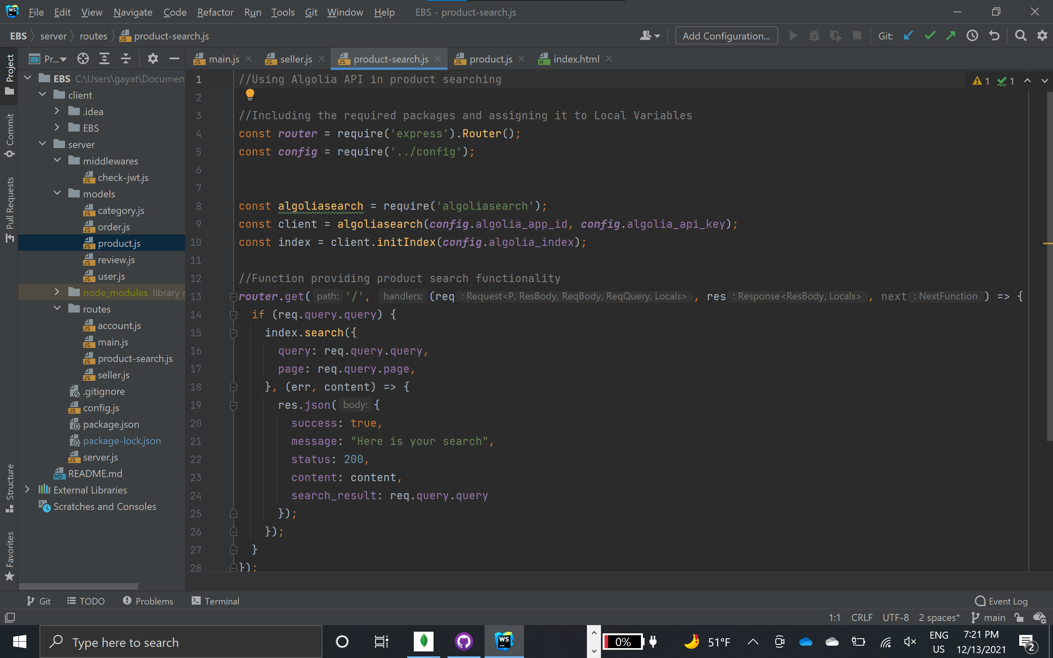
Product search.js
To facilitate product search using Algolia search API. We are using secret keys and index name of search API to perform the task.

Slide 29
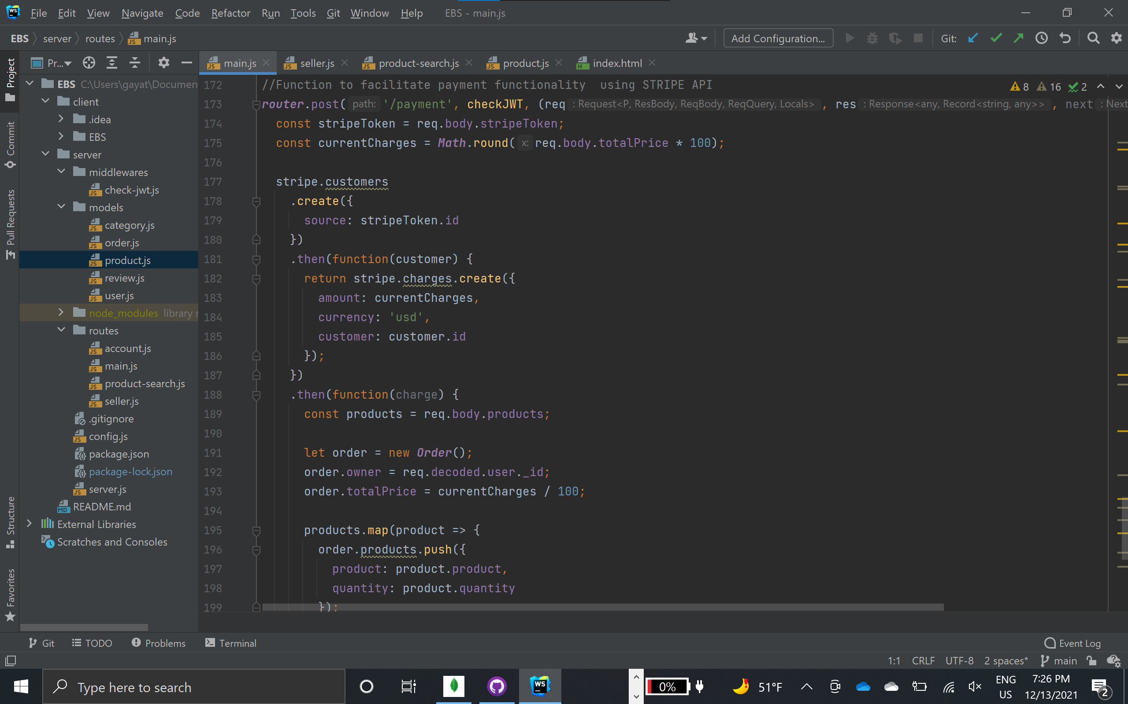
Main.js
To facilitate payment functionality using STRIPE API.

Slide 30
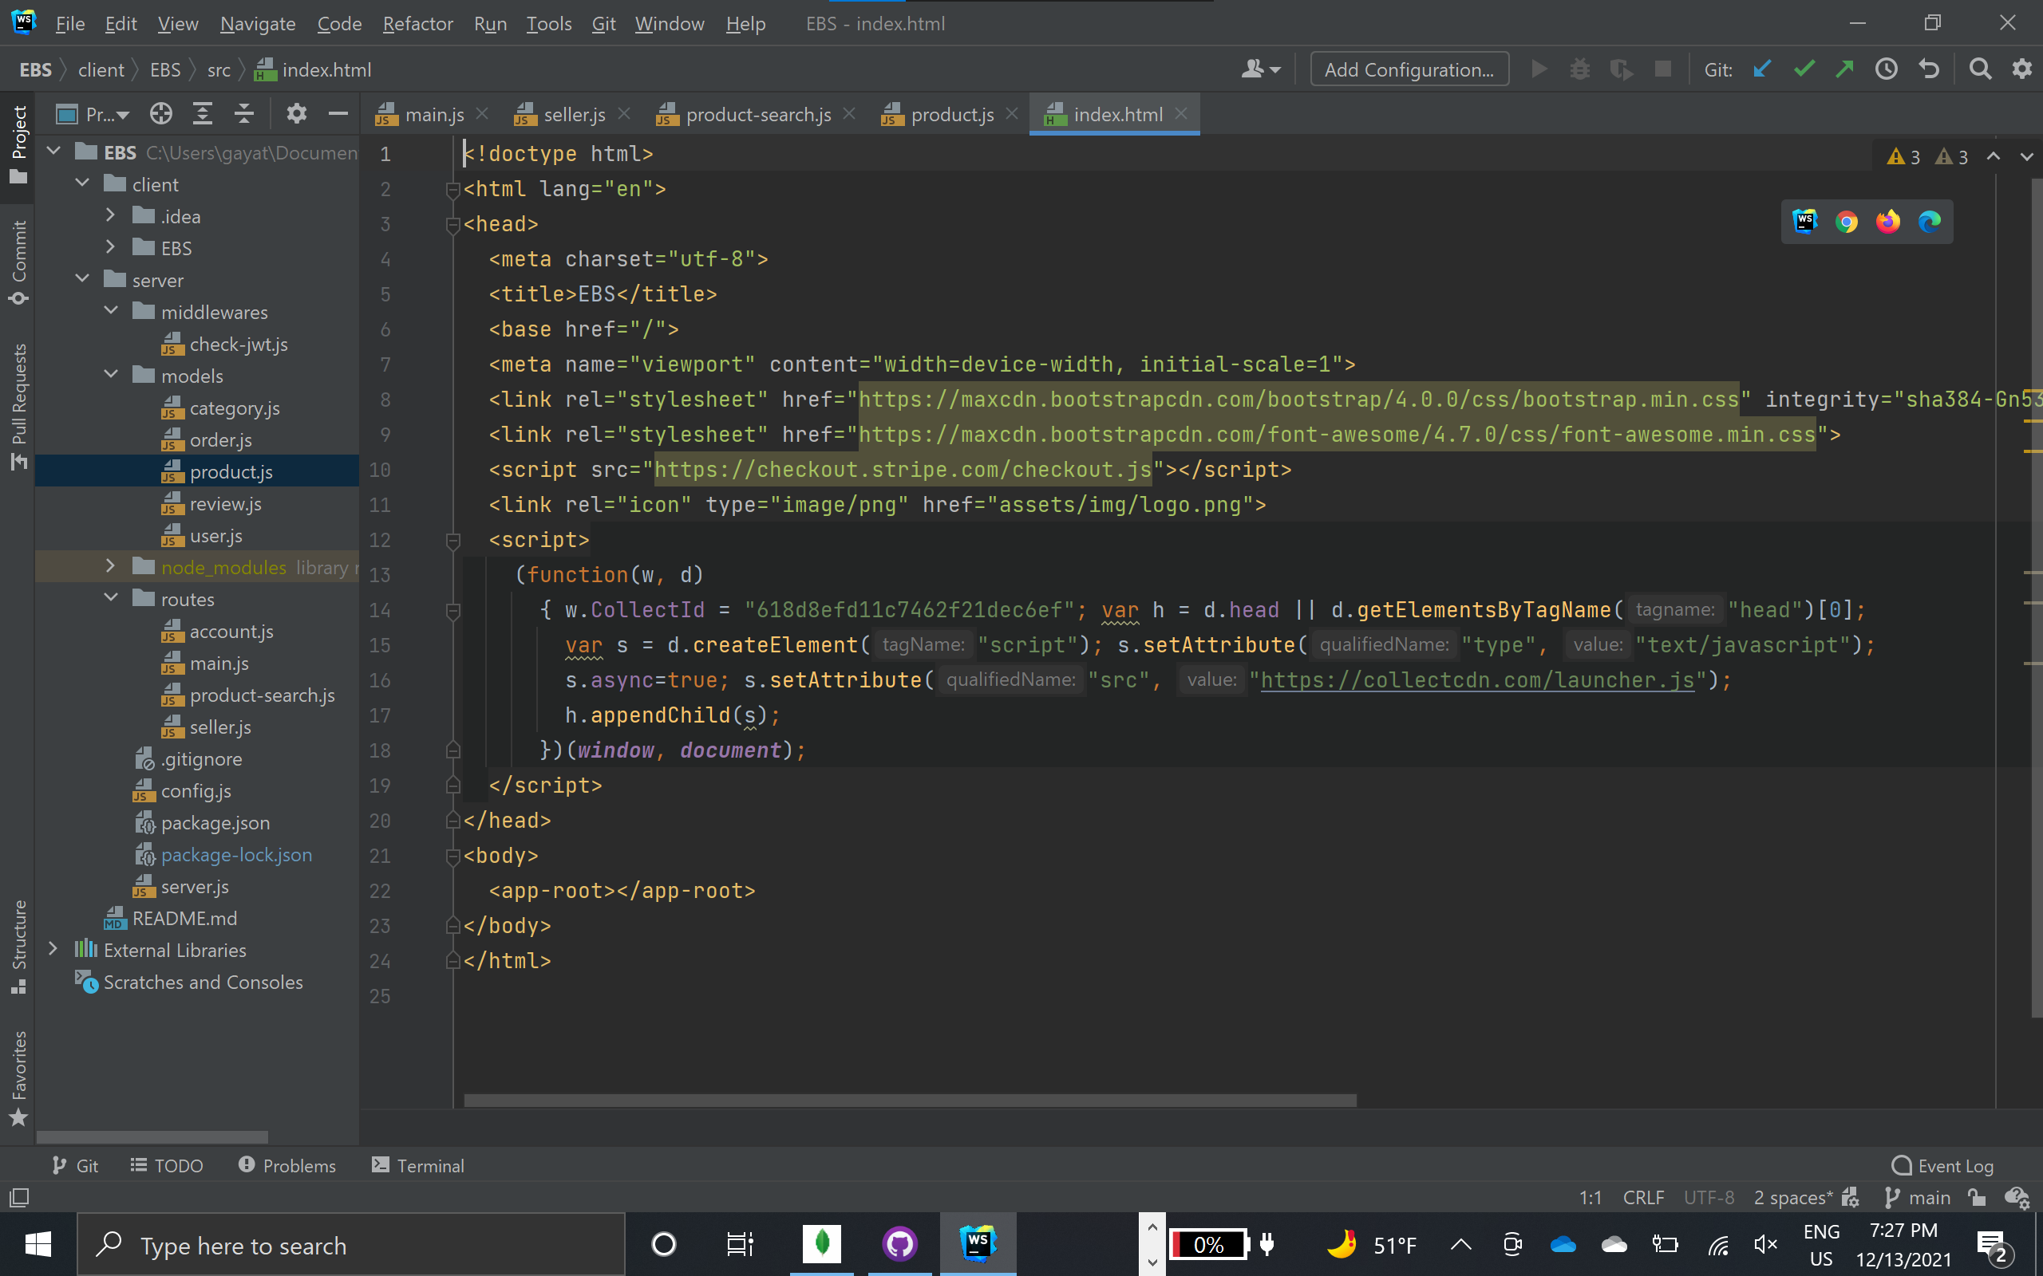
Index.html
To implement ChatBot functionality, we included the script generated in collect.chat dashboard.

Slide 31
Work sharing
Vidya D:
Worked on profile and review components, tried to implement multiple shipping address feature for placing order.
Karthik Y:
Worked on database models, storing database on cloud and backend code for routes. Worked on Stripe Payment API issue and added simple chatbot using collect.chat website.

Slide 32
Work sharing
Gayathri G:
Worked on adding Algolia search API for product search, account creation, logging in and product feature implementation.
Pujitha T:
Worked on post products, account settings and order details. Completed checking the orders in database and UI after Stripe issue is resolved.
Common Work:
Worked on report and presentation for the work said above.

Slide 33
Issues/challenges
Due to a version change for the Stripe API, we had an issue processing payment due to a "Stripcheckout" error during the product checkout.
We were able to find a solution to the problem. We didn't have enough time to add the additional capabilities to the application because the end-to-end work took so long, therefore we'll try to incorporate these functionalities (Split payments and multiple address delivery) as part of future work.

Slide 34
GitHub link: https://github.com/kar-gits/EBS
Video Link: https://youtu.be/bobL7H5Y2ac
Presentation link:
https://docs.google.com/presentation/d/1Qk3mM6iY9BWeVRHPXJZQNO70Qy9iyhKr/edit?usp=sharing&ouid=107184809928603804089&rtpof=true&sd=true

Slide 35
References
https://github.com/kar-gits/EBS
https://www.algolia.com/doc/rest-api/search/
https://stripe.com/docs/api
https://angular.io/docs
https://www.mongodb.com/developer/learn/?content=Articles&text=Node.js
https://nodejs.org/dist/latest-v14.x/docs/api/synopsis.html

Slide 36
???

Slide 37
Thank You…

